Slide 1
HYBRIDITY OF VALUE
VALUE OF HYBRIDITY 2020
Online Seminar 4-5th of November 2020
Tampere University, Faculty of Business and Management & IRSPM SIG ”Governing and managing hybridity”

Slide 2
WELCOME ALL!
THE BACKGROUND OF THE WORKSHOP
Special Interest Group session in IRSPM Tampere was cancelled
New forms of organizing scientific workshops needed
Developing innovative research agendas for researching hybridity, hybrid governance and organizations

Slide 3
Special Interest Group (SIG/IRSPM): Governing and Managing Hybridity

Slide 4
SIG: Governing and Managing Hybridity
Current research is inapt for theorizing the most important aspects of societal governance: why and how do the distinct forms of ownership and institutional logics sometimes contradict and collide, while at other times, via collaborative design, promote societal aims?
SIG investigates the relationships, balance, potential rationalities, and complications among public, private, and civic domains contributing to societal outcomes.
The impacts of hybridity on the design, strategies, value creation, performance, measurement and evaluation of the modern service delivery systems
Shared ownership between public and private owners in different institutional settings
Goal incongruence and different institutional logics in organizations and macro-systems
Variety in the sources of financing
Differentiated forms of economic and social control
Hybridity of professions
Links between institutional structures, logics and people in different contexts and settings of hybridity

Slide 5
SIG Mission
EXPLORE
The mission of SIG is to explore the most important limitations, complications in hybrid governance, but also the strengths and potentials of hybrid arrangements in society.
UNITE
The aim of the SIG is to unite researchers from separate areas of study to have an open debate on governing and managing hybridity in society, aimed at dealing with complex societal issues
COORDINATE
The SIG aims at coordinating the dispersed research discussion on hybridity in the public management community. This is an important opportunity, for both for the existing and new members of the IRSPM community.

Slide 6
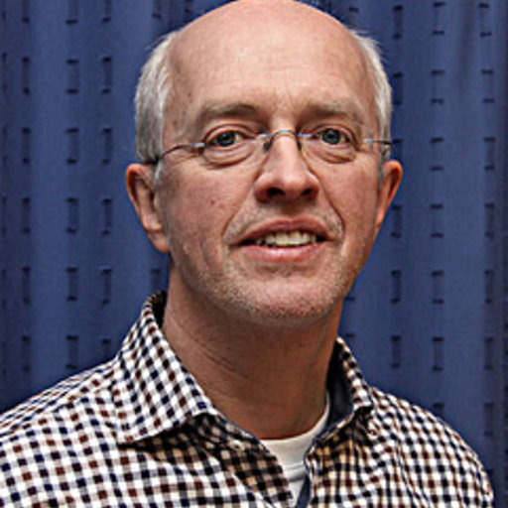
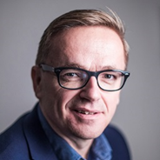
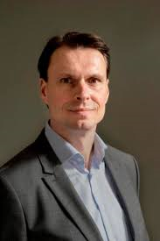
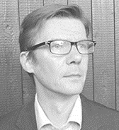
SIG Coordination team
SIG board: Wouter van Dooren, Adina Dudau, Giuseppe Grossi, Marieke van Genugten, Philip Karré, Jan-Erik Johanson, Mirko Noordegraaf, Matti Skoog, Harald Torsteinsen, Jarmo Vakkuri
SIG Chairs: Marieke van Genugten, Philip Karré, Jan-Erik Johanson, Ulf Papenfuss, Jarmo Vakkuri
Contact person: Adina Dudau (Adina.Dudau@glasgow.ac.uk)
Adina Dudau
Harald Torsteinsen
Giuseppe Grossi
Jarmo Vakkuri
Matti Skoog
Mirko Noordegraaf
Wouter van Dooren
Jan-Erik Johanson

Slide 7
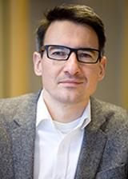
Special interest group (SIG), IRSPM panel chairs: Governing hybrid organisations
Panel co-chairs
Ulf Papenfuss
Philip Karré
Marieke van
Genugten
Jarmo Vakkuri
Jan-Erik Johanson

Slide 8
Research activities, including special issues on hybridity in the making
Public Budgeting, Accounting & Financial Management
Accounting, Auditing & Accountability Journal

Slide 9
SESSION 1.
CONTEXTUALIZING VALUE CREATION IN HYBRID GOVERNANCE
Wed. 4.11.2020 13:00-15:00
Welcoming words: Hybrid governance, organisations and society – Value creation perspectives.
Jarmo Vakkuri and Jan-Erik Johanson, Tampere University, Faculty of Business and Management
Governing through hybrid accountability: A theoretical model.
Adina Dudau, University of Glasgow, Adam Smith Business School
Dealing with multiple values in the hybridity contexts.
Giuseppe Grossi, Nord University, Business School, Jan-Erik Johanson, Tampere University, Faculty of Business and Management and Jarmo Vakkuri, Tampere University, Faculty of Business and Management

Slide 10
SESSION 2.
HYBRIDITY OF VALUE - EXPERIENCES FROM THREE CONTINENTS
Wed. 4.11.2020 15:30-17:30
Hybrid governance and performance management in the Swedish free-school sector – a potential case of “accountability dyslexia”. Matti Skoog, Åbo Akademi.
Fuel subsidy in hybrid companies in the oil and natural gas industry: Factors and motivations. Joaquim Rubens Fontes-Filho, Brazilian School of Public Administration at the Getulio Vargas Foundation
Understanding the current context of hybrid organizations in Canada: A comparative case study. Jennifer Hall, School of Public Administration, University of Victoria and Michael O’Neill, University of Ottawa, School of Political Studies

Slide 11
SESSION 3.
HYBRIDITY OF VALUE IN CORPORATIZATION
Thu. 5.11.2020 10:00-12:00
Corporatization as a strategy for public service provision. Anna Thomasson, Lund University School of Economics and Management
A gradual change perspective on corporatization: the institutionalization of the Danish State Guarantee Model for transport infrastructure. Lene Tolstrup Christensen, Department of Organization, Copenhagen Business School and Giuseppe Grossi, Nord University, Business School.
Corporatization in local government – Cultural differentiation and governance challenges. Harald Torsteinsen, University of Tromsø, Department of Social Sciences.

Slide 12
SESSION 4.
MODELLING HYBRID VALUE
Thu. 5.11.2020 12:30-14:30
Evaluating hybrid management models. Harri Laihonen, University of Eastern Finland, Department of Health and Social Management and Petra Kokko, Tampere University, Faculty of Business and Management.
Value creation by hybrid organizations. Philip Karré, Erasmus University Rotterdam, Department of Public Administration & Sociology.
Nested hybridity in Nordic higher education. Elias Pekkola, Tampere University, Faculty of Business and Management.

Slide 13
The Main features of hybridity in previous research (Johanson & Vakkuri 2017)
Shared ownership (e.g SOE).
Goal incongruence and different institutional logics in the same organization (eg. SE).
Variety in the sources of financing (eg. PPP).
Differentiated forms of economic and social control (e.g professional control).
Photo: Erik Johansson

Slide 14
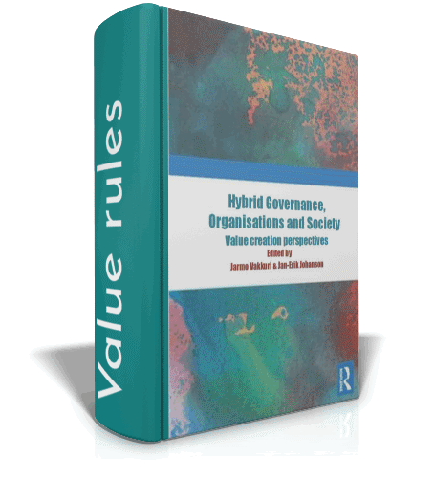
New title on hybrid value creation. Hybrid governance, organisations and society. Routledge
Hybrids can unite public, private and voluntary actions, but motivating forces and activity-building engines are attuned to value creation differently.
Government value-creation efforts are contrasted with the value-capturing endeavours of private enterprises and restrictions on beneficiaries in local communities.
Topical examples: Social enterprises, State-owned enterprises, Social welfare organisations, Project organisations, Pension governance, Higher education institutions
ISBN Ebook 978-0-367-22211-6
ISBN hardcover 978-0-429-28624-7

Slide 15
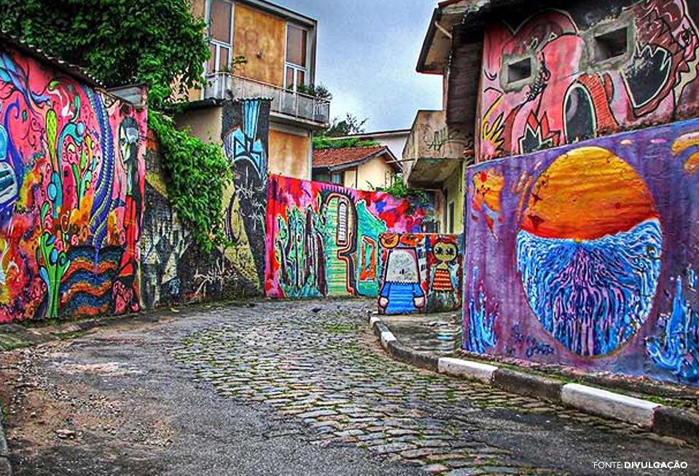
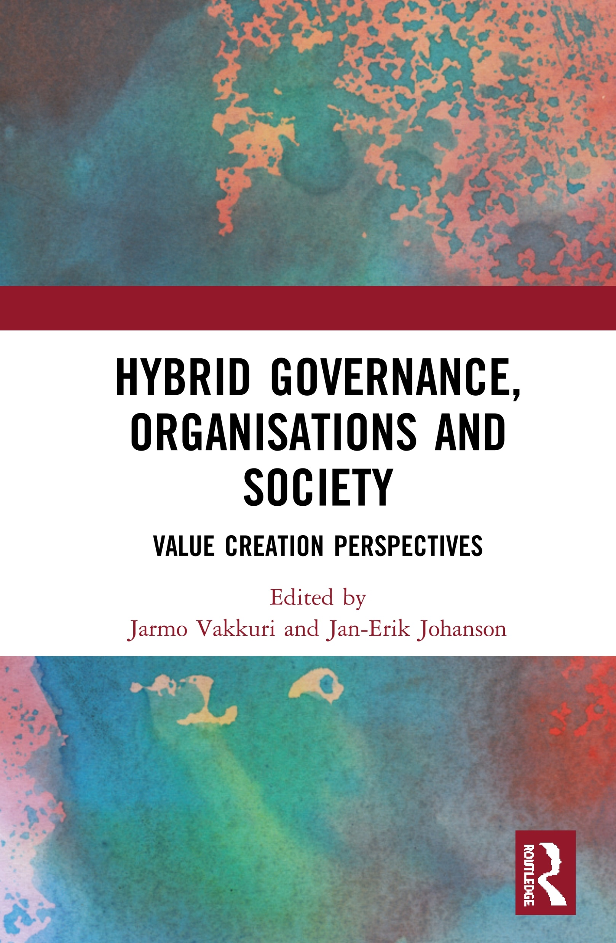
Legitimizing
value
State-owned enterprises
Hybrid
Projects
&
Mixing value
governance
Pension hybrids
Social enterprises
7
Social service hybrids
COUNTRIES COVERED
Compromising on values
Higher education
14
CHAPTERS

Slide 16
Doing value. The world of verbs

Slide 17
Three main types of value creation in hybrids (Vakkuri & Johanson 2020)
Mixing. The aim of generating novel variants of value create new combinations based on existing values. These combinations may evolve “by design” or “by default” (e.g. Triple Helix, NPM)
Compromising. Reconciliation of the different, competing value creation logics through compromises. This requires solving of grievances among the interacting parties (e.g. CSR schemes)
Legitimizing. Hybrids may be used for harvesting legitimacy for value creation. There are both constraints from external audiences as well as opportunities for hybrids to benefit from the multiplicity of audiences (e.g contexts of pension schemes)
The Flying Carpet, Ivan Tsarevich

Slide 18
Hybrid value creation is a game
Think of a game of Scrabble
Individual letters have value, but it is realized only when you are able to place letters on the board
Sometimes you augment the value of your words just by supplementing existing ones on the board (mixing)
Sometimes you need to make compromises with your co-players on the suitable words (compromising)
Sometimes you need to consult a dictionary (legitimizing)

Slide 19
Hybrid governance of bike sharing in China (Xu & Lu 2020)
Some 20 enterprises launched sharing of about 20 million bikes in China in 2017
Public encouragement of private provision of bike sharing
The problem of storage, repair, reuse and disposal of defunct bicycles
The implications for urban sustainability and protection of the environment

