Slide 1






Evaluating Hybrid Management Models
Based on two evaluations carried out by the HYPER research group (Jarmo Vakkuri, Jan-Erik Johanson, Petra Kokko, Tomi Rajala and Harri Laihonen)

Slide 2
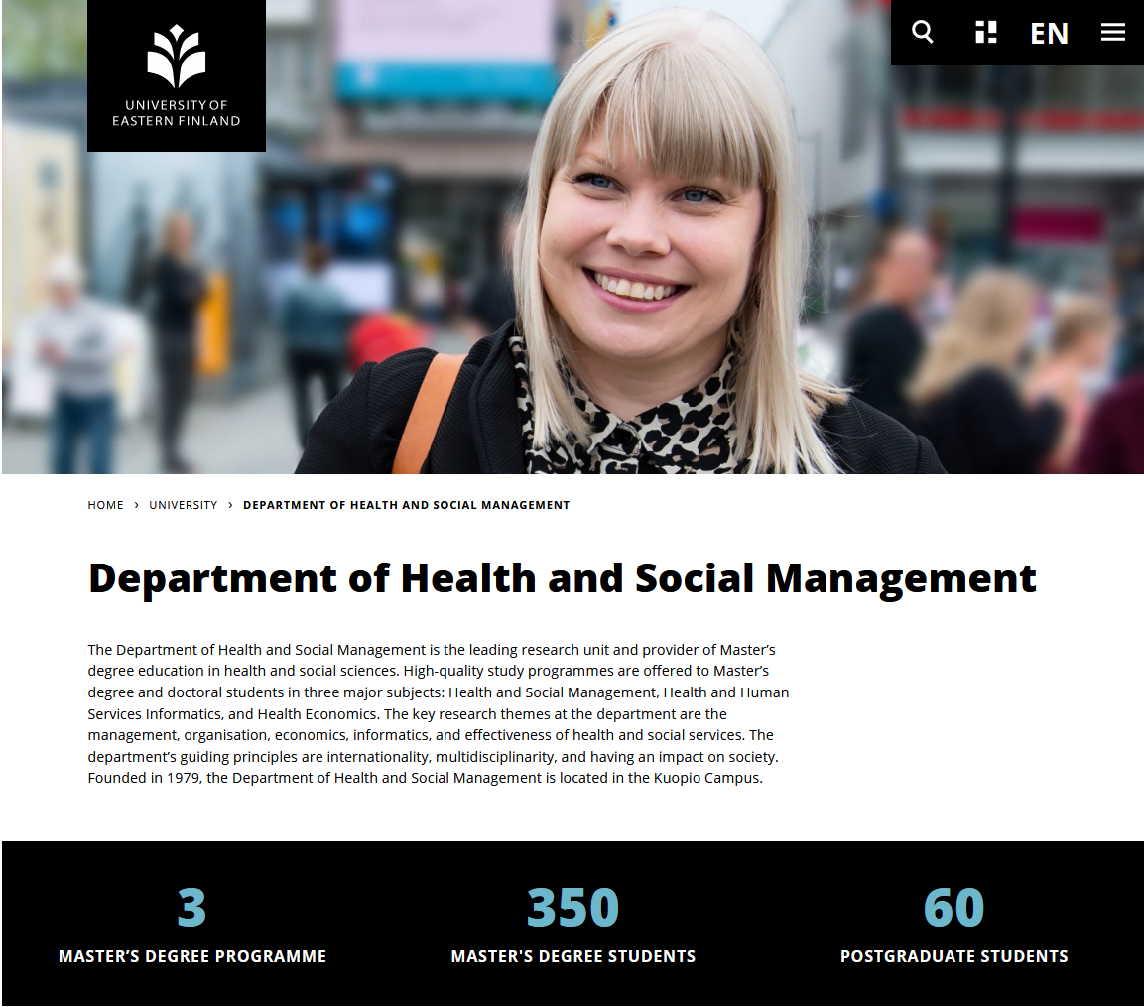

Slide 3
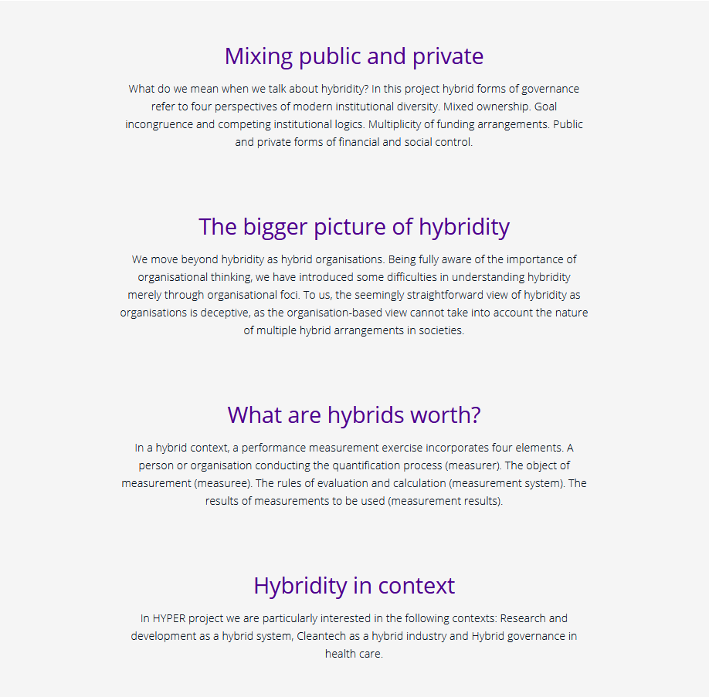
Agenda
An example of how basic research can contribute to practice.
Key learnings from two evaluations of hybrid organizations (or their management models)
Read more: https://projects.tuni.fi/hyper/

Slide 4
Academy of Finland project
Performance measurement for hybrid governance
Research project on performance measurement for hybrid governance in the Faculty of Management and Business at the Tampere University. Project begun on fall 2017 and lasts until August 2021. Principal Investigator is Professor Jarmo Vakkuri and the main source of funding is the Academy of Finland.
The general purpose of this project is to study external and internal performance measurement systems in hybrid forms of governance and the ways in which those metric systems influence and shape decision-making rationalities of hybrid institutions.

Slide 5
Basic research project as a platform for
Practice-oriented evaluation project
In spring 2018, the HYPER group agreed with the City of Tampere on an evaluation project in which the group will evaluate two existing hybrid organizations (combining public, private and third sector actors).
The aim of these evaluations was to support the further development of the models (what works well and what could be improved).
Timeline for the evaluation project was 1.6.2018-30.9.2018 and it was carried out in three main phases: 1) constructing an evaluation framework, 2) collecting the data, 3) analysis and reporting.

Slide 6
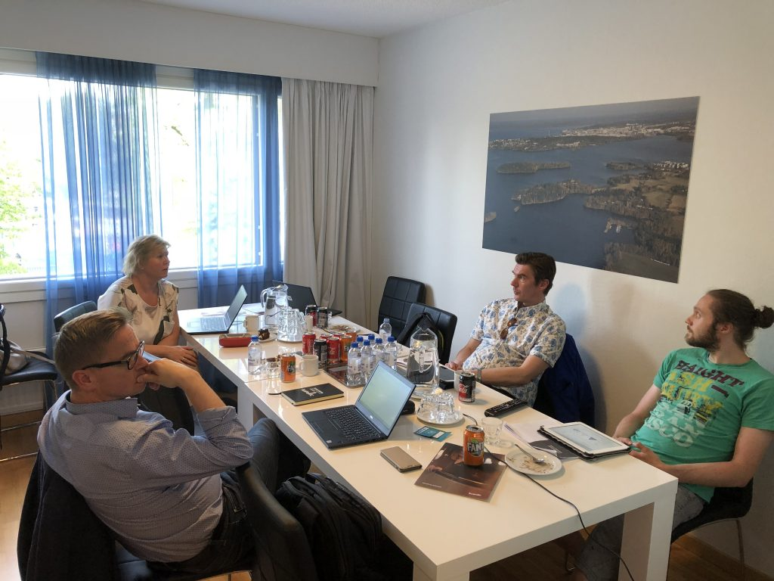
Steps 1 and 2
Evaluation framework and the data
1. Constructing an evaluation framework
2. Two empirical contexts
Document analysis (purchasing models; collaboration and alliance agreements)
Interview study (n=12)
Head of service provision (2)
Project manager (2)
Management group (3+5)

Slide 7
Evaluation framework
Organizing and responsibilities
Hybridity builds on trust and flexibility, leaving room for organizing.
Commitment and
engagement
Engagement of actors requires special attention because participation is voluntary.
Situation awareness is a precondition for hybrid arrangements – measurement and knowledge flows need to work well.
Objectives
Measurement and knowledge flow
Ambiguity of objectives is intrinsic for a hybrid organization.

Slide 8
Two empirical contexts
Accountable Care Organization
City of Tampere and local Heart hospital have innovated a new model, called Accountable Care Organization (VHO), which was adapted in the Finnish healthcare system by combining principles from the United States and the UK.
The City of Tampere, the Heart hospital, the Joint Municipal Authority of the Pirkanmaa Hospital District and the Heart association.
Focus on heart failure care paths.
Tesoma Wellbeing Centre
The city of Tampere executes the welfare services of Tesoma in a new type of partnership. The city provides the services in a joint effort of own organization and a bid-winning service provider or a group of service providers.
Dental clinic, maternity and child health clinic, library, youth centre, laboratory, counselling and information and counbselling desk, café.
Focus on citizen’s wellbeing.

Slide 9
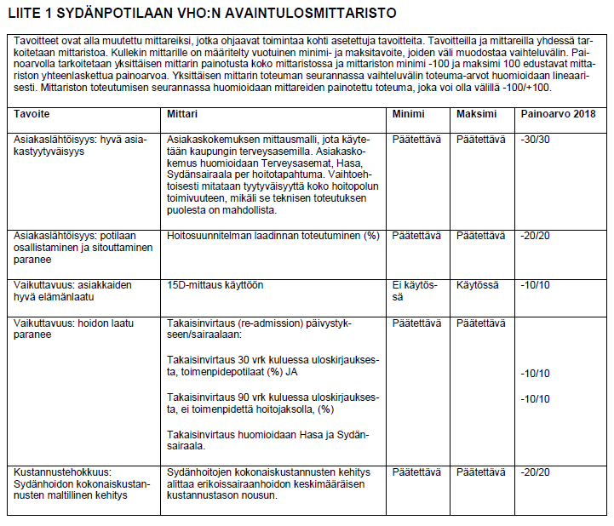
Accountable Care Organization
Objectives
Objective was to improve:
  Customer-orientation,
  Effectiveness, and
  Cost-efficiency
Sydänpotilaan vastuullinen hoito-organisaatio VHO - Hankintamallin kuvaus

Slide 10
Tesoma Wellbeing Centre
Objectives
City’s objectives | Objectives of the Tesoma wellbeing centre
Renewing service models…. | Improving wellbeing in Tesoma Healthier and more active citizens
Experimentation….platform….enabler...innovations… collaboration…participation…. | B) Profitability and development Profitable and cost-efficient… Renewing and developing practices… Limited public funding (max. xx. euros)
Improving overall welfare in the area. | C) Fit for purpose services Continuous and open development of services Service experience
Integration of social and healthcare…strengthening third sector…citizen participation…
Low-threshold services…eServices…. Counselling…self-service…
Lähde: Tesoman hyvinvointiallianssi - Hankintamallin kuvaus

Slide 11
Evaluation summary
Main managerial challenges in hybrids
 | Accountable care organization (VHO) | Tesoma welfare alliance (THA)
Objectives | Objectives create commitment among actors; there are no conflicts (or at least those are not mentioned) Underlying principles are observable (ACO, New care model and Shared savings) Operational logics are close to each others; shared care path guides operations, but it remains unclear how process optimization has been taken into account in objectives (time lag, lead-time, early warnings)? | Objectives create commitment among actors; there are no conflicts (or at least those are not mentioned) Objects seem to relate more to other ongoing projects than THA ‘s own process. Agreement model creates mixed incentives.
Organization and responsibilities | Data analysis provides support for operations management and organizing; clear roles and sharing of responsibilities Collaboration is based on trust and appreciation; this will be truly weighted when someone has to give up something Instilling the model, its continuity and sustainability; strong reliance on some key persons and lack of well-established practices as risks | Collaboration is a shared ambition, there are clear differences between cultures (public vs. private). Organizing and responsibilities are unclear on critical areas Management responsibilities are about to from; supervision of work and administrative vs. decision-making; clear responsibilities?
Engagement and commitment | Actors credit openness and voluntary nature of the model; joint decision-making and innovativeness as incentives Monetary incentives are not in use yet; remains to be seen how those will engage; resources and possibilities to participate differ Loose coupling may create a risk for continuity and sustainability | Complex relationships between objectives and actor’s commitment more complex than (challenge for management control) Commitment disappears if own/personal objective are not connected to objectives of the THA. New practices for engagement – training, interaction and diverse collaboration
Measurement and knowledge flow | Key questions regarding knowledge flow relate to objectives, organizing, commitment, reporting (e.g. care plan) and communication Human risks related to data governance and reporting Missing measurement information on process optimization (e.g.. time lag, lead-time, early warnings)? | Building of a shared knowledge base incomplete Measuring the value of the new model difficult (shared value) Problems in knowledge flow relate to objectives, organizing, commitment, and reporting.
Managerial challenge: How to develop a shared agenda and objectives?
Managerial challenge: How to organize responsibilities, build trust and enable continuous dialogue?
Managerial challenge: How to motivate and enable participation?
Managerial challenge: How to agree on shared measures and analyze data together?

Slide 12
Key learnings
Takeaways for the management group
Strategic
Special attention to a) service system, b) customer orientation .
VHO ja THA different cases: different hybrids solve the problems in a different way, calls for case-specific solutions.
Objectives change during the life-cycle: commitment vs. strategic management.
Engagement and commitment in an important role: enable sustainable change, learning from others and long-term impacts of the network.
Development of measurement practices is a necessity for showing the shared value and acceptability of the model.
Practical tips
Create clear focus and story between different level objectives.
Ensure data integration.
Make responsibilities explicit.

Slide 13
Academic contribution?
For sure…we already had an abstract ☺

Slide 14

Thank you!
uef.fi

