Slide 1
‘Value of Hybridity 2020’- seminar, Tampere University,
4-5 November 2020
A gradual change perspective on corporatization: the institutionalization of the Danish State Guarantee Model for transport infrastructure
Postdoc Lene Tolstrup Christensen, PhD, Department of Organization, Copenhagen Business School, Denmark, ltc.ioa@cbs.dk
Giuseppe Grossi, Professor in Public Management and Accounting
Nord University, Norway, E-mail: giuseppe.grossi@nord.no
Kristianstad University, Sweden, E-mail: giuseppe.grossi@hkr.se
Notes:
https://www.routledgehandbooks.com/doi/10.4324/9780203097571.ch14

Slide 2
Research context and questions
Literature review on corporatization
A gradual change perspective to corporatization
Research Strategy for the longitudinal case study of the SGM
Institutionalization of the SGM as a new mode of corporatization & Governance implications
Conclusions & contribution

Slide 3
Research context and Questions
On the backdrop of the NPM reforms (Hood, 1991) new forms of organization for public service and infrastructure such as Public Private Partnerships (Hodge et al. 2010) were introduced.
Recently, focus on more mundane and yet widespread form of state-owned enterprises (SOE) (Bernier et al. 2020; Grossi et al. 2015) highlighting the research gap on contemporary corporatization (Ferry et al., 2018; Voorn et al., 2017).
Introducing the framework of gradual change to the literature on corporatization:
analyze corporatization as a process over a longer period of time and not as an abrupt change (Streeck & Thelen, 2005).
analyze how reform elements over time are mixed (T. Christensen & Lægreid, 2011; Polzer et al., 2016).
This is done via an in-depth qualitative longitudinal case study (Eisenhardt & Graebner, 2007) of 1) the institutionalization of the Danish state guarantee model (SGM) for transport infrastructure as a model for contemporary corporatization, and 2) the long-term governance implications.

Slide 4
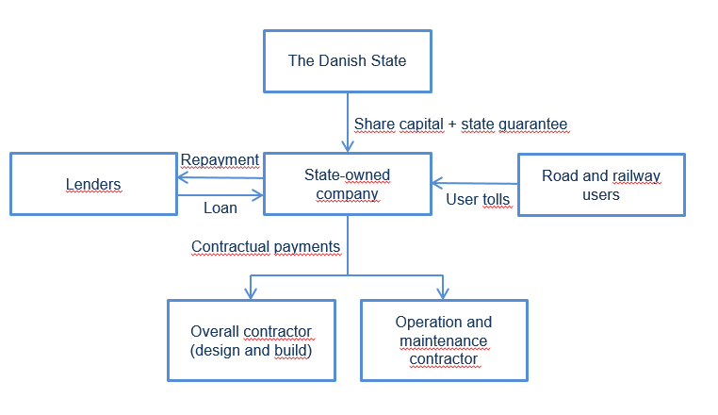
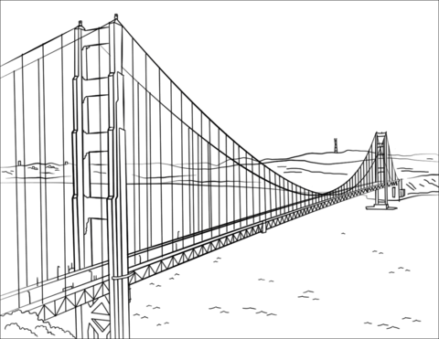
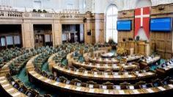
SGM and the Danish context of transport infrastructure governance
 | Agency model | SGM
Authority | The Danish state | Danish state, but can be bilateral
Financing | Finance act | State guaranteed loans
Payback | No user charges for roads and subsidized user charges for public transport | User charges (or other commercial income)
Organizational unit | Agency | Project SOE (SPV)
Governing principles | Laws and policies | Construction act + enterprise law
Realization (DBMO) | In-house/ Contracting-out | Contracting-out
Danish State Guarantee Model (SGM) that since the late 1980’s has been used for mega Danish infrastructure projects
SGM accounts for estimated 50% of the state’s infrastructure spending (Danish Transport Infrastructure Commission, 2008)
No development of a policy or regulation for the use of the model (Danish Ministry of Finance, 2019)
30+ pay back period

Slide 5
Literature review on corporatization
Arguments | Authors
Models | Wettenhall &Thynne (2002); McDonald (2014); McDonald (2016)
Reasons (or drivers) and expected results | Thynne (1994); Wettenhall (2001); Grossi & Reichard (2008); Tavares (2017); Voorn et al. (2017); Ferry et al. (2018); Andrews et al. (2019)
The changing role of State, accountability and controlling mechanisms | Guthrie (1993); Thynne (1994); Jørgensen (1999); Haque (2001); Christensen, & Lægreid (2003); Bruton et al. (2015)

Slide 6
Gradual Change (GC) in Public Administration
GC perspective is used to understand institutional complementarities and national differences (Bezes & Lodge, 2015), hybridity (Polzer et al., 2016, Christensen & Lægreid, 2011) and policy changes especially in classical historical institutionalist areas of industrial relations (Graf, 2018, Lambert, 2016) and social policies (Koreh et al., 2019)
GC focuses on formal institutions, but the formal rules are basically considered imperfect with gaps in every reform (Mahoney & Thelen, 2010).
Provides a room for interpretation and change for the actors - such as the rule makers, e.g. politicians, ministries or regulators, and the rule takers e.g. companies and interest groups - to interpret how the institutions are to be understood (Hacker et al., 2015), which allows for gradual change (Mahoney & Thelen, 2010).

Slide 7
Gradual change mechanisms in the analysis
Layering is
when a new institution is ‘put on top’ of the existing institution
new institutional elements are attached as amendments to existing institutions (Mahoney & Thelen, 2010), as new rules (Conran & Thelen, 2016).
Conversion is
when an existing institution is redirected towards new goals, functions or purposes.
reinterpretation is central, as it is when political actors are able to redirect institutions towards purposes beyond their original intent (Hacker et al., 2015).
Displacement happens
when new institutional arrangements occur as old institutional elements are discredited and alternative institutional forms are discovered (Streeck & Thelen, 2005).
it can occur as new institutions are introduced that compete directly with older sets of institutions (Mahoney & Thelen, 2010).
Different from layering, this type of change needs cultivation from endogenous actors that have been on the periphery and are better served by the new arrangements or by rediscovered ‘new’ institutional elements (Streeck & Thelen, 2005).

Slide 8
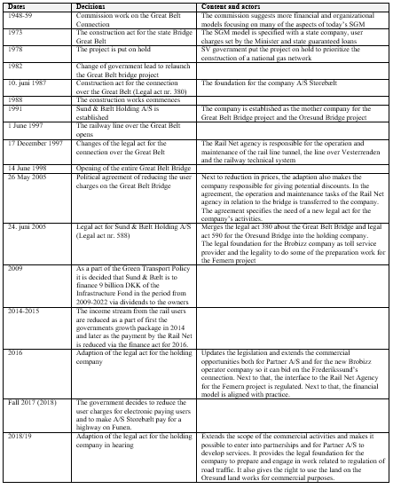
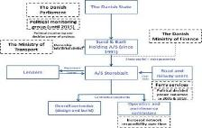
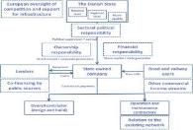
Longitudinal and in-depth case study
All transport infrastructure projects based on the principles of SGM (Danmarks Nationalbank, 2018)
Analytical strategy to focus on the SGM as the governance model in each project and hereby analyse the institutionalization of the SGM as a contemporary model for corporatization and mode of governance across the projects and over time
Decision making tables
for each project
SGM basic figure 1
adapted for each project
Institutionalized SGM figure
Interview guides and
indication of periods in
institutionalization
6 explorative interviews
and search for official
documentation
Document analysis of material of the seven projects
12 semi-structured interviews with public authorities for and executive management in the seven projects
Triangulation via document
analysis of legal proposals
for all seven projects
One researcher based in a SGM based SOE company carrying out interviews, informal talks and discussion with executive management and specialist employees combined with observations in the period August 2018 - March 2019

Slide 9
Timeline of the politically decided projects (project volume: 30 billion euros)
Construction Act CPH Metro Cityring
(3.3 billion Euros**)
Construction Act the Frederikssund Connection
(266 million Euros****)
Sund & Bælt Holding A/S established
Construction Act CPH Metro Sydhavnen
(1.2 billion Euros**)
Construction Act CPH Metro 1+2
(2.1 billion Euros*)
Construction Act the Great Belt Connection
(6.7 billion Euros*)
Split of metro activities into By & Havn I/S
(1,97 billion Euro debt***)
Construction Act the Oresund Connection
(4.6 billion Euros*)
Construction Act the Fehmarn Connection
(8,4 billion Euros*)
Construction Act the Capital Light Rail
(830 million Euros***)
Construction Acts merged into Sund & Bælt Holding
Split of metro activities into Metroselskabet I/S
Construction Act CPH Metro Nordhavn
(387 million Euros**)
1987
1991
1992/93
2005
2007
2013
2014
2015
2016
Layering of the SGM as new model for infrastructure
Conversion of project companies to SOEs
Displacement into new hybrid models

Slide 10
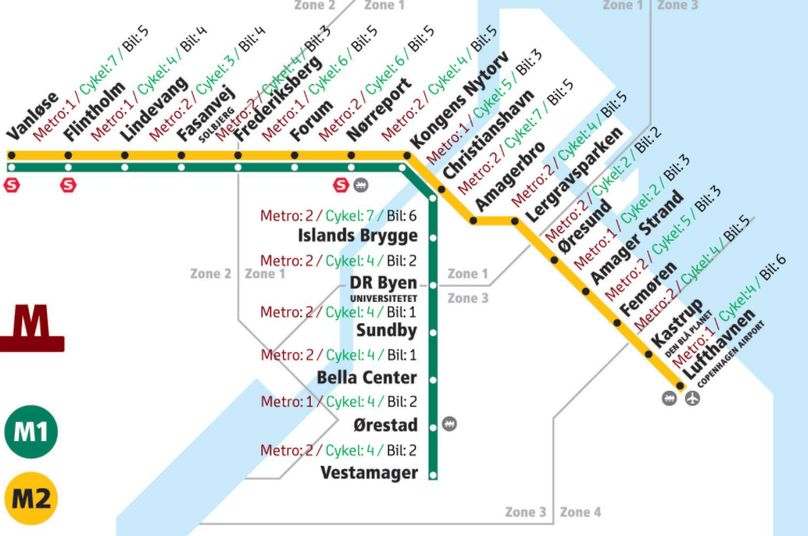
Institutionalization of SGM
Great Belt Connection
(6.7 billion Euros*)
1. The Layering of the SGM (1987-1993)
Layering of new mode of governance with the decision to construct the Great Belt Bridge in 1987 as SGM
Lock-in commences with the decision to build the Oresund bridge (Denmark-Sweden)
Organized in newly established Sund & Bælt Holding A/S to reduce costs, strengthen learning between the two projects and secure coordination
International dimension with state treaty
Institutionalization is enforced with the Metro as layering of a SGM model for public transportation
Copenhagen Metro 1 & 2
New commercial income stream: passenger revenues are combined with divestment of pre-developed land
Oresund Connection
(4.6 billion Euros*)
CPH Metro 1+2
(2.1 billion Euros*)

Slide 11
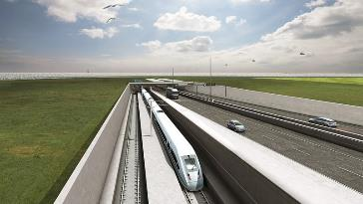
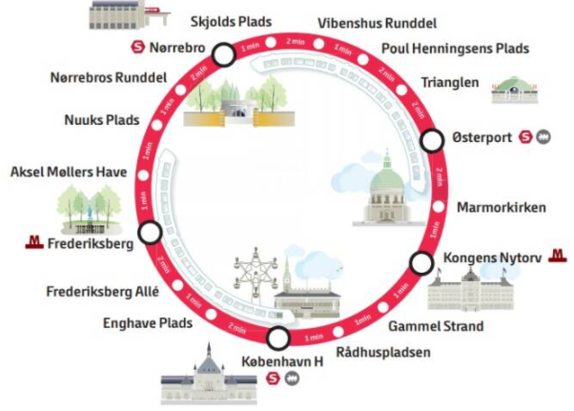
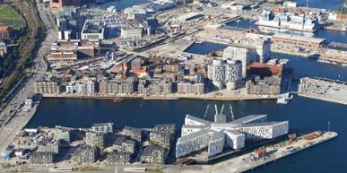
Institutionalization of SGM
Fehmarn Connection
(8,4 billion Euros*)
2. The conversion of the project companies into a new SOEs (2005-2013)
The ‘lock-in’ of the SGM path is reinforced with learning and coordination effects from the previous projects
Decision to build Fehmarnbelt Link project in Sund & Bælt
Decision to build City Ring metro project in Metroselskabet
Conversion towards a modern SOE way of governing in infrastructure governance
As the SGM based SOEs move from project orientation to competence centers
In 2005, the construction acts for the Great Belt Bridge and the Oresund Bridge into Sund & Bælt Holding A/S.
The Metro activities from three project based SOEs to two entities By & Havn I/S (2007/08) and Metroselskabet I/S (2007)
The modern SOEs get preliminary planning tasks
Sund & Bælt; Frederikssund’s Connection
Metroselskabet: the Capital Light Rail.
Displacement process commences as public co-finance is introduced for the metro City Ring and breaks fundamentally with SGM basic
CPH Metro Cityring
(3.3 billion Euros**)
By & Havn I/S
(1,97 billion Euro debt***)

Slide 12
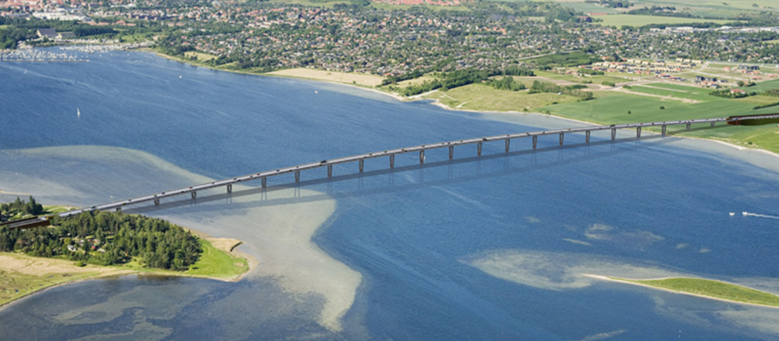
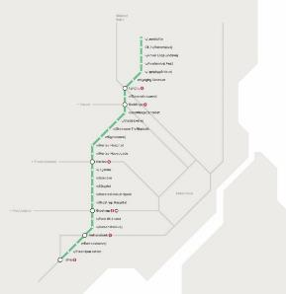
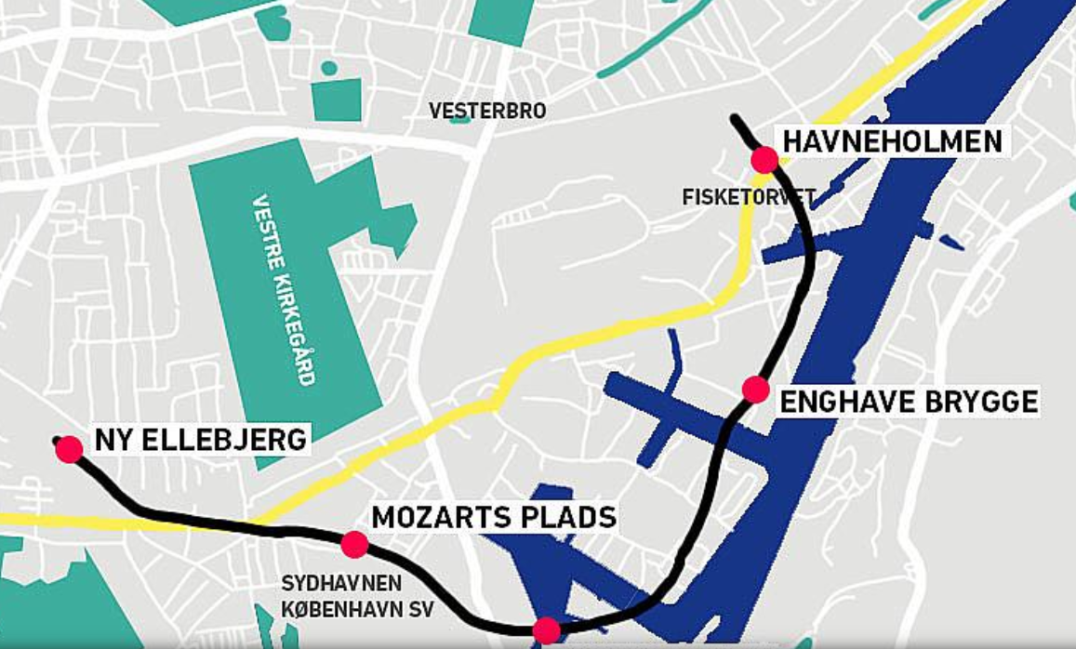
Institutionalization of SGM
Frederikssund Connection
(266 million Euros****)
3. The displacement of the layered SGM and agency into new hybridity models (2014- today)
Displacement of the SGM model as it is used for more things by different actors and gets potential to gradually change the dominant agency model with public financing of infrastructure from within
In 2014, the Frederikssund’s connection
In 2015, with the Sydhavn Metro line
In 2016 with the Capital Light Rail
Layering of SGM enforced and conversion of modern SOE as a part of the public network
In 2015, the construction act for Fehmarn
Increasing funding of infrastructure outside SGM
Pricing level of SGM projects for bridges and tunnels are locked by transport network effect
Capital Light Rail
(830 million Euros***)
CPH Metro Sydhavnen
(1.2 billion Euros**)

Slide 13
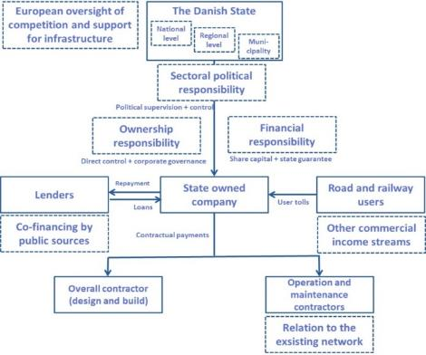
Institutionalization of SGM
SGM is an organizational and financial form of governance that over time changes meaning and is altered a process of layering and displacement of this layered mechanism in the old institutional repertoire of public agency model.

Slide 14
Conclusions
RQ 1: Institutionalization of SGM as a contemporary mode of corporatization
The case shows how a corporatization takes place as the new invention of the SGM has introduced new independent SOE to realize mega transport infrastructure projects in a layering process next to and outside the existing governmental organization of agencies and corporatized utilities.
It shows that the newly layered SGM is institutionalized towards more publicly dependent models (hybrid) in a displacement process where institutional actors take the basic SGM and adapt it to their purpose.
In this process, the original project companies are converted to modern SOEs, which are increasingly embedded in the overall infrastructure governance of the agency model.
RQ 2: Long term governance implications
At the organizational level, the SGM projects are institutionalized over time, into a new way of political organizing next to the existing ministry structure evolve in term of modern SOE with specific expertise and ability to finance an upgrade of the exisiting network
The SGM also introduces a new governance model for tolling and off the balance sheet financing into the Danish transport infrastructure governance without any debate of normally untouchable political issues.

Slide 15
The interlinkages between the three different gradual change mechanisms in corporatization
- Planning tasks and execution of new SGM projects
Conversion of SOEs
Layering of SGM
Displacement of hybrid models
SGM finance of public transport network
Public co-finance of new SGM projects
New actors
Temporary SGM structure
Agency responsibility in new SGM projects
Agency model (context)
Phase I:
Layering of the SGM as new model for infrastructure
Phase II:
Conversion of project companies to SOEs
Phase III:
Displacement into new hybrid models

Slide 16
Contribution
The paper contributes by theorizing how different gradual institutional mechanisms play together over a long period of time (Koreh et al., 2019) and also by showing and conceptualizing how corporatization influences coexisting governance modes (Christensen & Lægreid, 2011)
A contemporary mode of corporatization that constitutes an alternative to public private partnerships (Graeme A. Hodge et al., 2010).
It also adds to the discussion on corporatization by showing how the physical character of the transport infrastructure as a network enables and constrains these mechanisms and therefore influences the agency of both politicians and bureaucrats in gradual change processes (Hacker et al., 2015)

Slide 17
Thank you for the attention!
Postdoc Lene Tolstrup Christensen, PhD, Department of Organization, Copenhagen Business School, Denmark, ltc.ioa@cbs.dk
Giuseppe Grossi, Professor in Public Management and Accounting
Nord University, Norway, E-mail: giuseppe.grossi@nord.no
Kristianstad University, Sweden, E-mail: giuseppe.grossi@hkr.se

