Slide 1
Inequality and STI Policies
Susan E. Cozzens
School of Public Policy, Georgia Tech
Globelics Academy, August 2022

Slide 2
Why this topic?
Growing attention to inequality
  Criticism of “top 1%”
  Capital growth will outpace wages
Sustainable development goal (SDG10)
  “Reduce inequality within and among countries”
  Applies to all countries, not just global South
Do STI policies need to pay attention?
Can STI policies make a significant difference?
Outline
  Unpacking Key Terms in SDG10
  Connections STI policy scholars have identified
  Strategic view – key leverage points

Slide 3
SDG10: Reduce inequality within and among countries.
Targets within countries
  Higher income growth in bottom 40%
  Empower and promote inclusion
  Eliminate discriminatory laws and policies
  Adopt wage and social protection policies
Targets among countries
  Improve regulation of global financial markets
  Ensure voice for developing countries in global institutions
  Facilitate orderly migration and mobility
  Implement special treatment for Least Developed Countries
  Encourage Official Development Assistance to LDCs
  Reduce transaction costs of migrant remittances
Notes:
Note that there is nothing on global inequality at the household level.
Note that the competitiveness agenda could undermine the human development agenda if it strengthens elites.
Nothing specifically here connected to STI – issues interlaced throughout the SDGs

Slide 4
SDG1: End Poverty in all its forms everywhere
Targets, by 2030…
  No one living on less than $1.25 per day
  Cut relative poverty rates in half
  Implement social protection systems, including floors
  Equal rights (to land, property, financial services, etc.)
    Includes access to “appropriate new technology”
  Build resilience to disasters, climate-related and other
  Ensure development assistance to end poverty in all its dimensions
  Pro-poor and gender-sensitive policy frameworks for ending poverty
Notes:
Targets
Indicators
1.1
By 2030, eradicate extreme poverty for all people everywhere, currently measured as people living on less than $1.25 a day
1.1.1
Proportion of population below the international poverty line, by sex, age, employment status and geographical location (urban/rural)
1.2
By 2030, reduce at least by half the proportion of men, women and children of all ages living in poverty in all its dimensions according to national definitions
1.2.1
Proportion of population living below the national poverty line, by sex and age
1.2.2
Proportion of men, women and children of all ages living in poverty in all its dimensions according to national definitions
1.3
Implement nationally appropriate social protection systems and measures for all, including floors, and by 2030 achieve substantial coverage of the poor and the vulnerable
1.3.1
Proportion of population covered by social protection floors/systems, by sex, distinguishing children, unemployed persons, older persons, persons with disabilities, pregnant women, newborns, work-injury victims and the poor and the vulnerable
1.4
By 2030, ensure that all men and women, in particular the poor and the vulnerable, have equal rights to economic resources, as well as access to basic services, ownership and control over land and other forms of property, inheritance, natural resources, appropriate new technology and financial services, including microfinance
1.4.1
Proportion of population living in households with access to basic services
1.4.2
Proportion of total adult population with secure tenure rights to land, with legally recognized documentation and who perceive their rights to land as secure, by sex and by type of tenure
1.5
By 2030, build the resilience of the poor and those in vulnerable situations and reduce their exposure and vulnerability to climate-related extreme events and other economic, social and environmental shocks and disasters
1.5.1
Number of deaths, missing persons and persons affected by disaster per 100,000 people
1.5.2
Direct disaster economic loss in relation to global gross domestic product (GDP)a
1.5.3
Number of countries with national and local disaster risk reduction strategies

Slide 5
Connections in the literature
Conventional STI policies increase inequality unless they are designed to do otherwise.
Different distributional effects across STI policy types
  Research
  Innovation
  Human resource
  Regulatory
Different effects vertically and horizontally
  Vertically = rich/poor (wealth, income)
  Horizontally = between culturally defined groups, e.g., gender

Slide 6
Research policy: advancing knowledge
Within countries
  In affluent countries,
    Attention to inequality tends to be focused on horizontal issues
    Ever more strongly linked to needs of private industry
  In countries with lots of poor people,
    Public health drives attention to major health challenges
    Major industries get lots of attention, e.g.,
      Mining in South Africa
      Sugar industry in Brazil
Between countries
  Research agenda of the North tends to dominate “international” research communities.

Slide 7
Innovation: new products and processes
Dynamics in global economic system
Large public research efforts in the North, contribute to innovation power of corporations, e.g.,
  Origins of tech industry in U.S. defense spending.
  Agricultural research and the seed and ag chemicals industries
Centers where new technologies emerge are still where wealth accumulates.
Innovation policies in every country tends to orient to the same competitive directions.

Slide 8
Human resource policies
Growing our own
  Investing in secondary and tertiary education
  Making research careers attractive.
  Encouraging women (and minorities in some places)
Attracting immigrants
  U.S. and Europe in particular
  Contributes to brain drain
Attracting talent to less affluent environments
  Well-funded positions for international stars
  Contributes in the short run to inequality within countries; tradeoff with longer term benefits?

Slide 9
Regulatory policies
Most address health, safety, environmental concerns.
  Assume that the protection helps everyone equally.
Distributional effects get explicit attention when there is a scare, along with other ethical issues, e.g.
  AI/ Robotics
  CRISPR - CAS
Uneven burdens of health and safety regulations seldom get attention.
  Does Europe care about effects of GM food bans for African agriculture?

Slide 10
Proposed alternative designs
By target area of inequality
  Pro-poor – bottom of income distribution
  Egalitarian – horizontal inequalities
  Equalizing – changing the shape of the economy
By innovation location or style
  Informal economy
  Grassroots innovation
  Frugal innovation
  Social enterprise
“Directionality” – problem orientation
  New Sussex Manifesto: distribution, diversity, directionality
Notes:
Given that there are many ways that STI interact with the dynamics of inequality within countries and on a global scale, how might STI policies be changed to have the most positive impact?

Slide 11
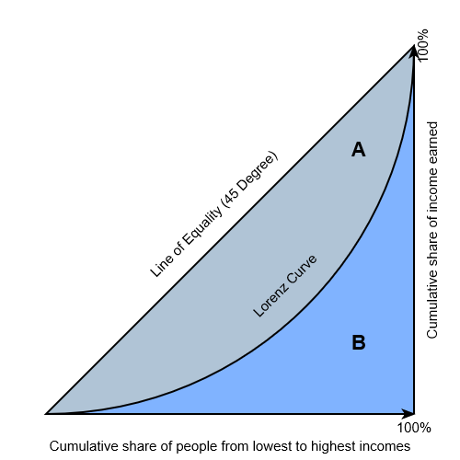
Where and how much?

Slide 12
Wealth and income gaps
Inequality within countries is growing almost everywhere.
  Global inequality at household level is dropping slightly.
Top end numbers are dramatic.
  Super high executive salaries
  Pre-pandemic, Oxfam reported that 26 people owned as much wealth as the poorest half of humanity.
    Wealth at the top grew $2.5 billion per day; declined 11% for 3.8 billion at bottom in 2018.
    Tax evasion, erosion of worker’s rights, cost-cutting, business influence on policy
  During the pandemic, a new billionaire was created every 33 hours (including 62 new food billionaires), and a million more people were forced into poverty at the same rate.

Slide 13
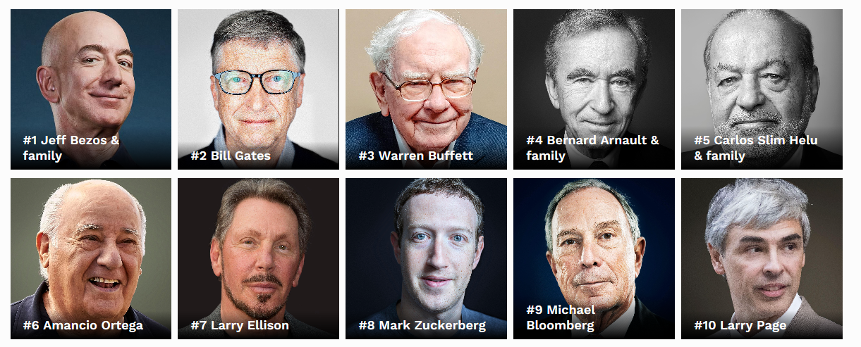
Do you see a pattern?
Source: www.forbes.com/billionaires
Notes:
Note Bezos (Amazon)
Gates (Microsoft)
Slim (telecom)
Ellison (Oracle)
Zuckerberg (Facebook)
Page (Google)
Buffett (investments)
Arnault (fashion)
Ortega (retail)
Bloomberg (finance, media)

Slide 14
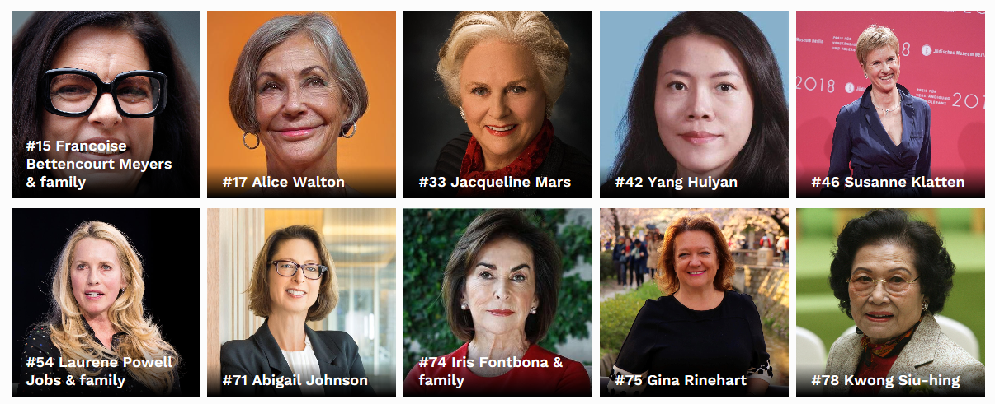

And oh, by the way …
Source: www.forbes.com/billionaires
Notes:
Bettencourt is cosmetics – L’Oreal. Alice Walton is of the Walmart family. Mars is actually in the candy business (Mars bars). Yang is real estate.
Susanne Klatten is BMW, pharmaceuticals, wind power.
Laurene Powell Jobs – another tech company fortune. $18.6 billion being put to work in part in for-profit social enterprises, according to Forbes.
Abigail Johnson is CEO of Fidelity, which has dabbled in bitcoins.
Kylie Jenner is the youngest self-made billionaire ever, displacing Mark Zuckerberg. Her business is cosmetics, spurred by 175 million online followers. The company has about a dozen employees and outsources production and marketing.

Slide 15
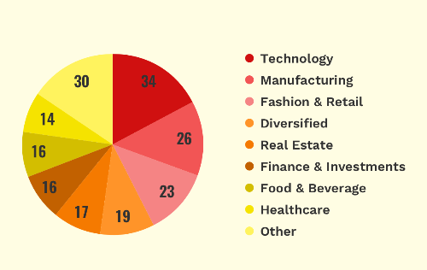
Where newcomers built their fortunes
Source: www.forbes.com/billionaires

Slide 16
Did STI policies contribute?
Essential to the innovation
  U.S. military needs
    Computing
  International research institutions
    Internet invented at CERN
    DARPA played early role in its growth
IP property policies facilitate accumulation of wealth
Notes:
Contribute to this piling up of wealth?

Slide 17
What policies would we redesign?
Other policies are clearly better suited to take on this top-end issue
  Redistribution through taxes
  Social responsibilities of corporations
Note that there is significant philanthropy represented in the list – will come back to this
Public research and development?
  E.g., defense R&D spending?
Intellectual property policies?
  See World Trade Organization/ TRIPS as arena

Slide 18
Addressing Poverty

Slide 19
Focus on livelihoods
Livelihood-producing options most likely to be powerful.
Bottom-up – important for “agents not patients”
  Informal economy
  Grassroots innovation
  Question: how much does policy action add?
Focusing on growing activities that produce middle-skill, middle-income jobs
  Should be part of local economic development strategy
  Could be a part of corporate responsibility

Slide 20
Trickle down from the middle

Slide 21
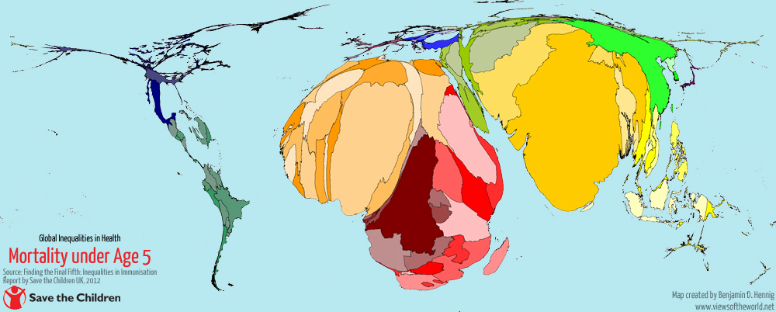
Living conditions and outcome gaps
Health inequalities as an example

Slide 22
Do STI policies contribute?
As reviewed earlier…
  Research agendas tilted to the North.
  IP provisions keep profits in the North.
  Innovation incentives do not direct product development to the needs of poor people.
  Pharma and biomed devices are probably a distraction.
On the other hand…
  Global public health community does a relatively good job of “directionality” although it can certainly be strengthened.

Slide 23
Pro-Poor “Directionality” Options
Private philanthropy is more strategically focused on these issues
  Gates focus on global health issues.
  Carter Center elimination of river blindness.
STI-based options
  Innovations for the bottom of the pyramid
    ICT4D has come up with lots of these
  Frugal innovations
    Spreading the benefits of new knowledge and techniques
  Social enterprise, particularly “fusion” businesses
    Aravind Eye Institute
Notes:
No good quantitative assessment available of impacts of these options

Slide 24
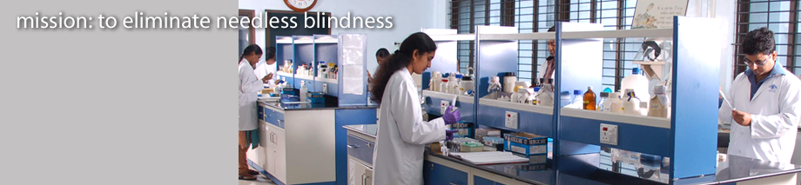
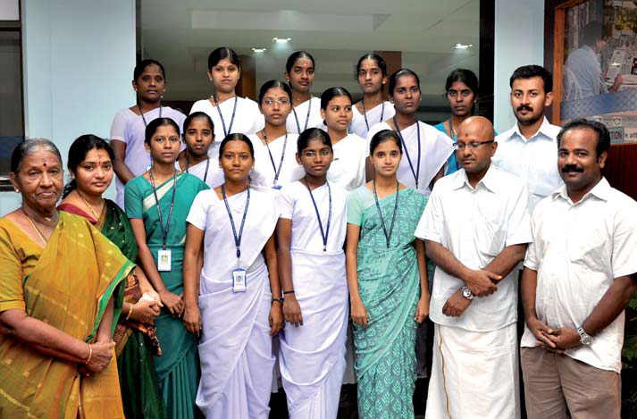
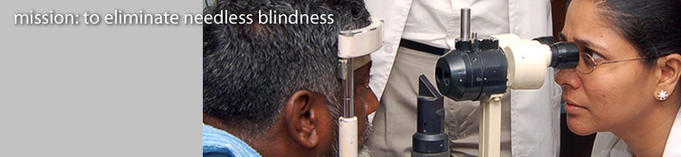
Aravind Eye care system: frugal innovation plus targeted job generation

Slide 25
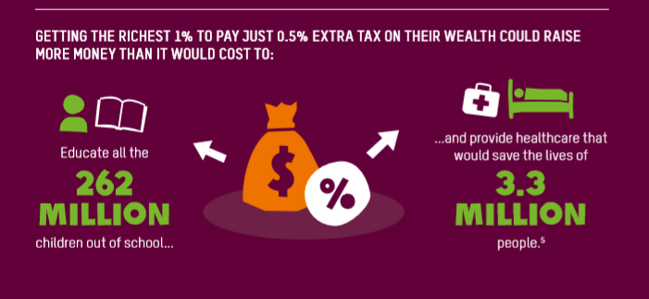
Non-STI leverage points
Economic redistribution
Source: Oxfam, Public Good or Private Wealth, 2019

Slide 26
STI leverage points: candidates
Redirecting public R&D
  1% shift in defense spending [$1.686 trillion in 2016 (world total per SIPRI)]
  1% shift = $168 billion
Top-down health investments
  World health statistics allow prioritization
Trickle down from the middle
  Generating middle-skill, middle-income jobs
Qualitative options
  Keeping IP within its traditional bounds
  Strengthening corporate responsibility
Notes:
$168 billion = about a third of US R&D spending

Slide 27
Discussion?

