Slide 1
Globelics Academy 2022, Tampere
Regional Innovation!
Rhiannon Pugh
Centre for Innovation Research, Lund University

Slide 2
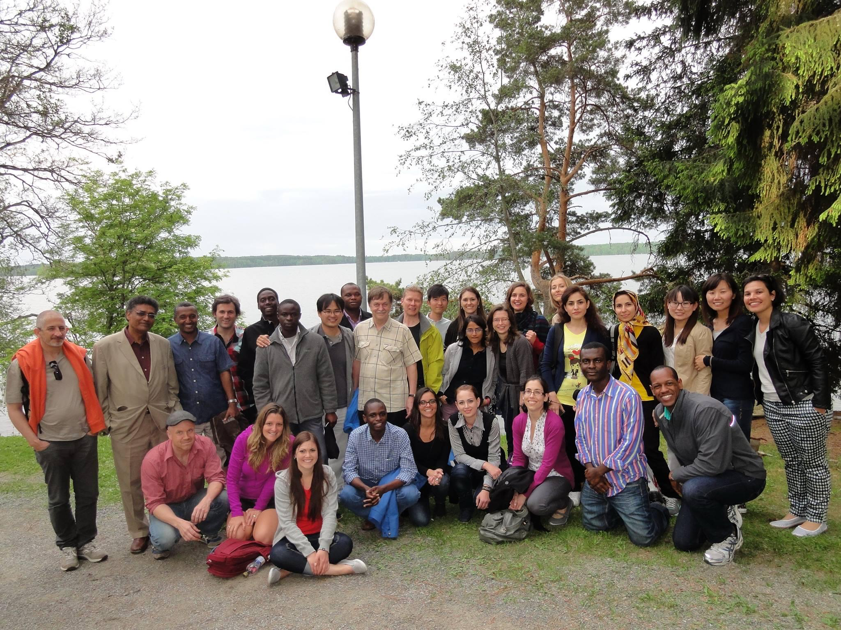


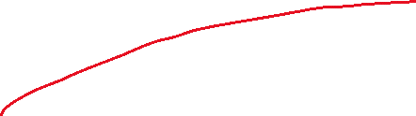
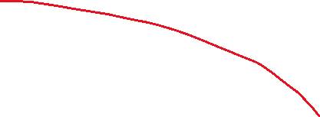
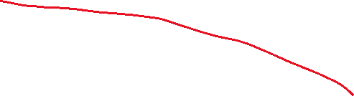
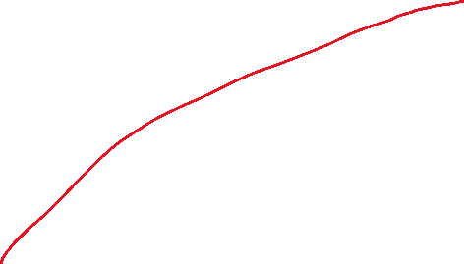


Qiantao Zhang
Mika Kautonen
Elisa Thomas
Kaija Valdmaa
Mika Raunio
Jana Schmutzler
Nadja Nordling

Slide 3
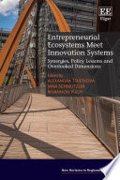

Slide 5
Today’s lecture
WHAT (is a region)
WHEN (is it studied, and by whom)
WHERE (has it come from and where is it heading)
WHY (is this a popular/valid research area)
HOW (are regions studied/ represented)
CASE STUDIES- Scotland, Catalonia

Slide 6
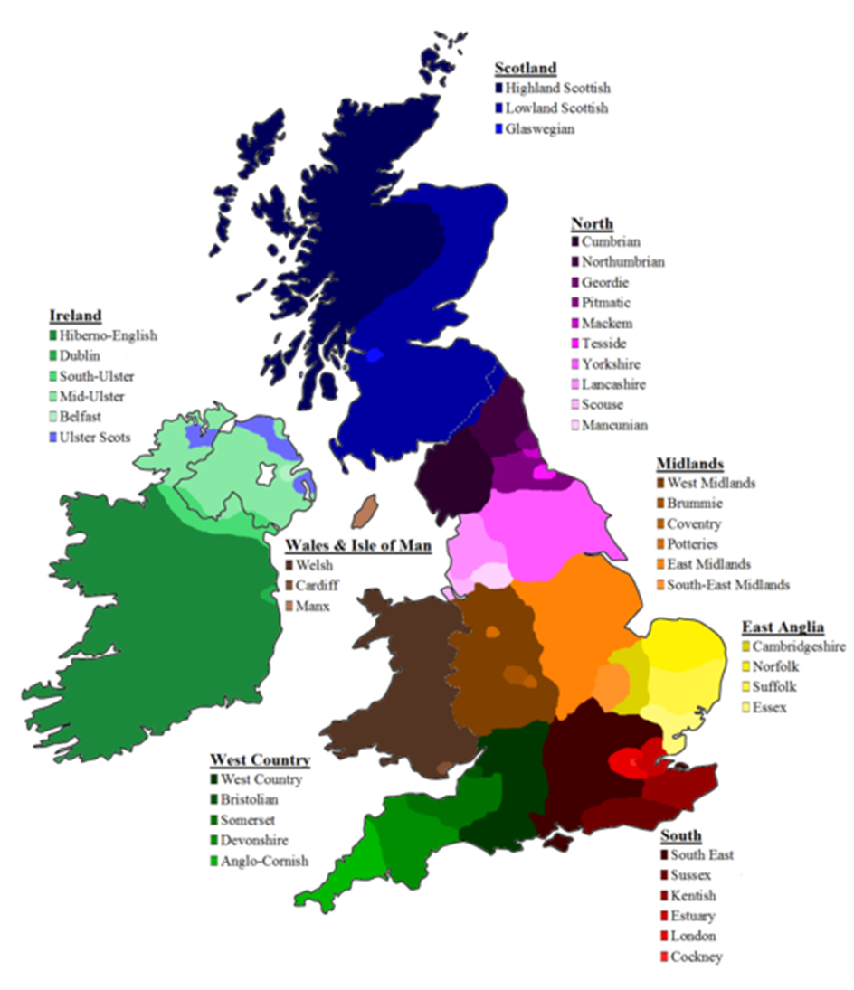

Slide 7
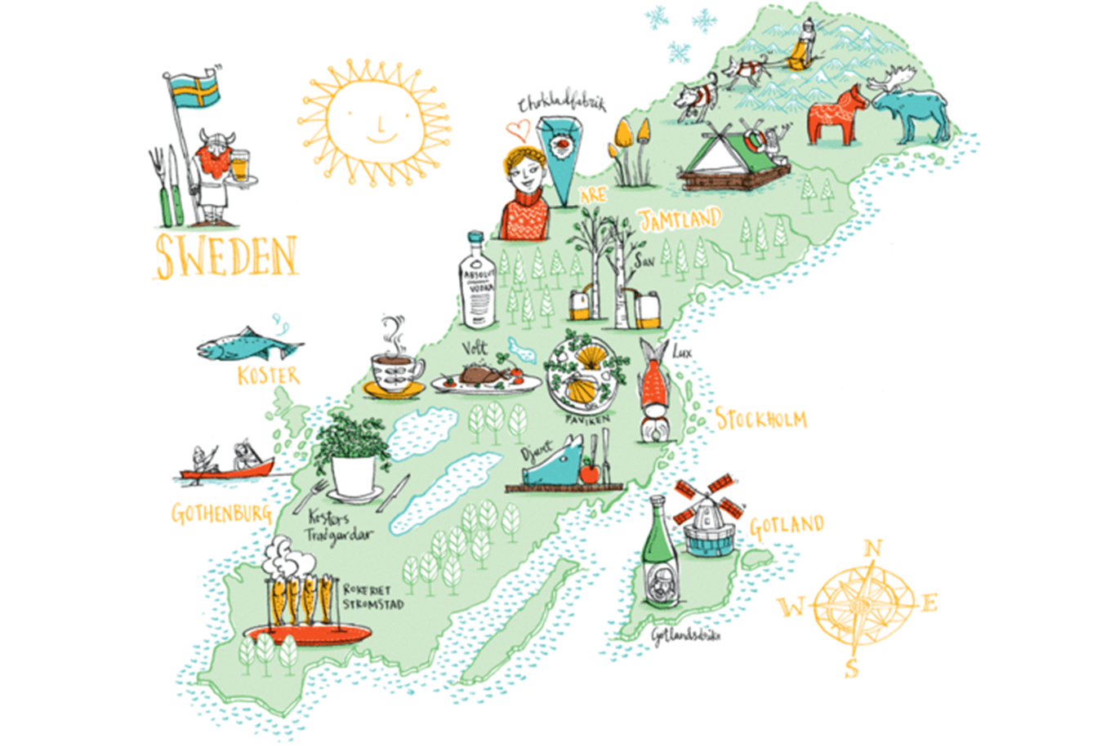

Slide 8
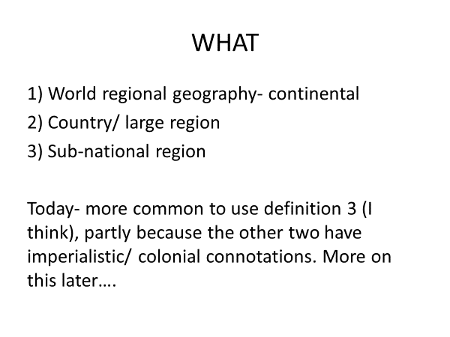

Slide 9
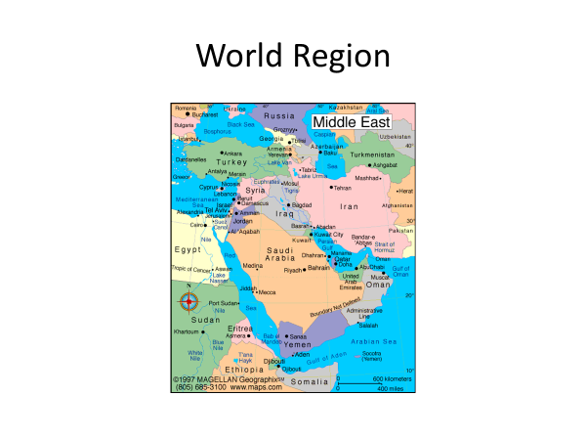

Slide 10
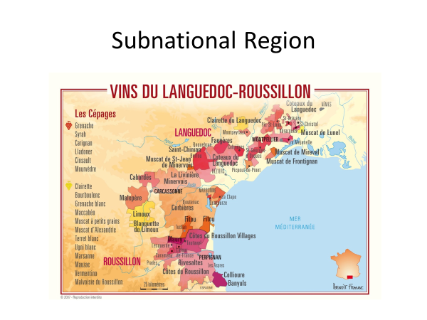

Slide 11
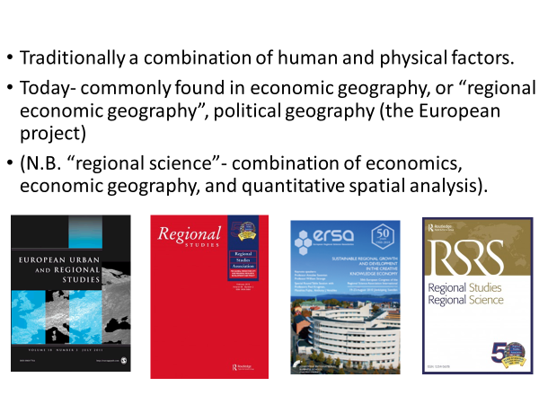

Slide 12
Harvey (1993) suggests that localized identities, especially when conflicted with race, gender, religious and class differentiation, are among the most dynamic bases for both progressive political mobilization and reactionary, exclusionary politics.”
Paasi, 2003, p.476.

Slide 13
Regional Innovation Systems
Grew out of and alongside NIS approach. Some examples:
Asheim, B. T., Moodysson, J., & Tödtling, F. (2011). Constructing regional advantage: Towards state-of-the-art regional innovation system policies in Europe?. European Planning Studies, 19(7), 1133-1139.
Niosi, J. (2005). Canada's regional innovation system: The science-based industries. McGill-Queen's Press-MQUP.
Riba Vilanova, Marta, and Loet Leydesdorff. "Why Catalonia cannot be considered as a regional innovation system." Scientometrics 50, no. 2 (2001): 215-240.

Slide 14
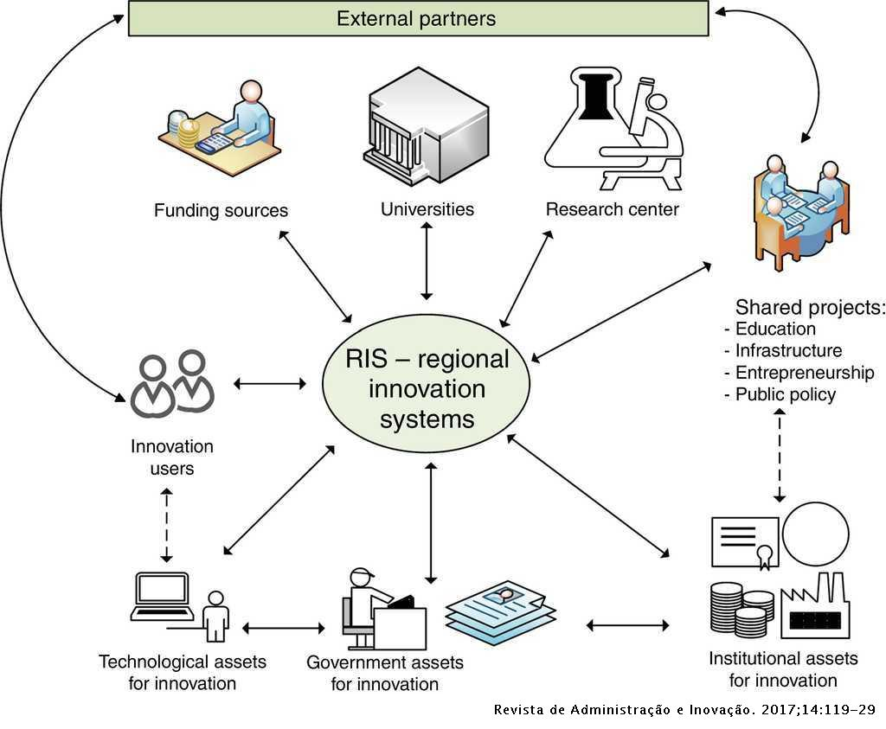
https://www.elsevier.es/es-revista-revista-administracao-e-inovacao-239-articulo-analysis-determinants-for-open-innovation-S1809203917300360

Slide 15
Regional Policy for Innovation….

Slide 16
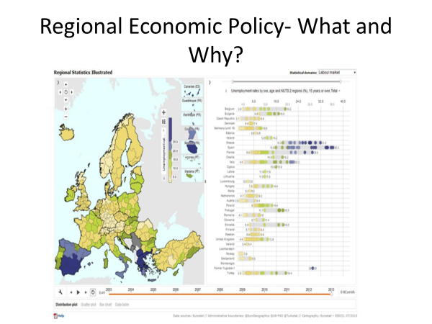

Slide 17
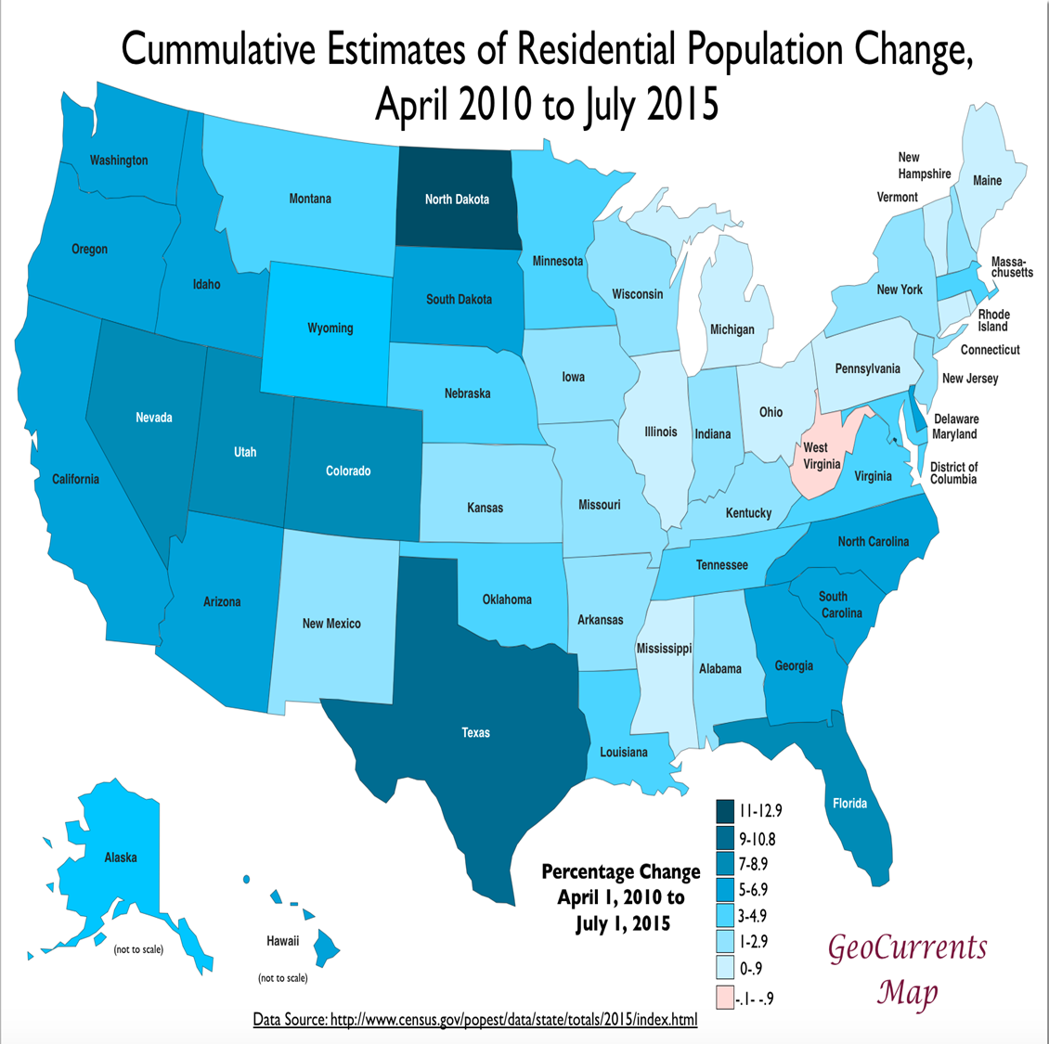

Slide 18
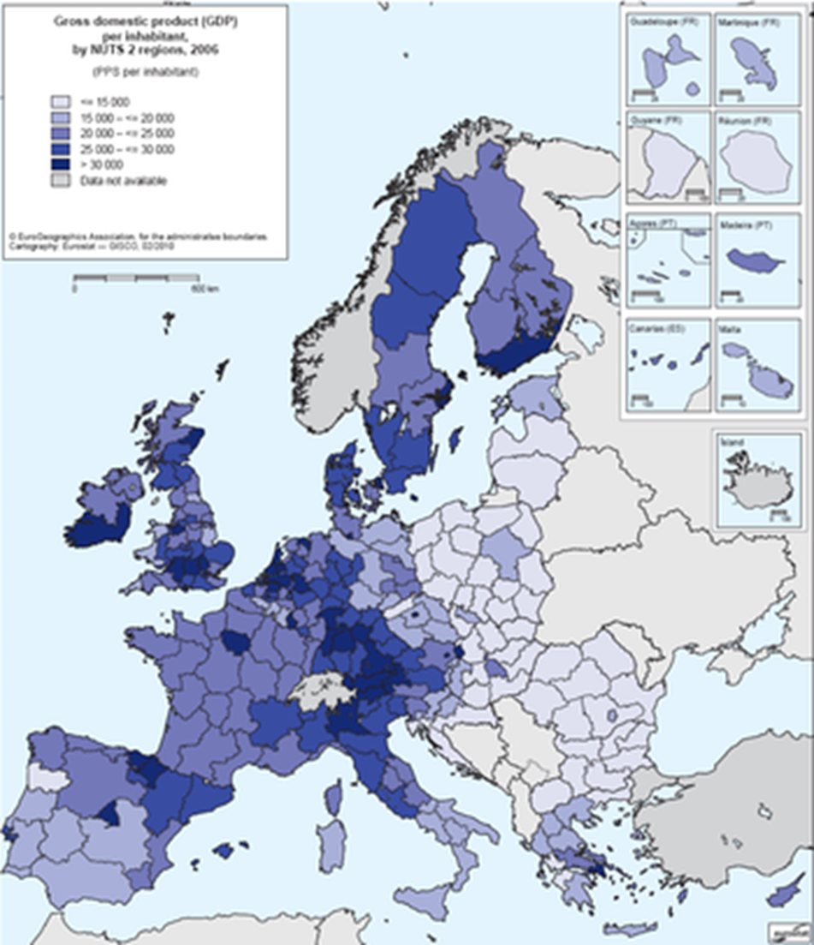

Slide 19
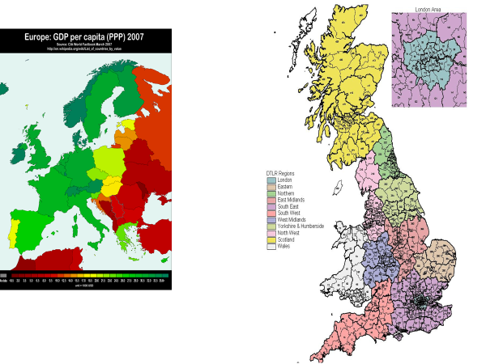

Slide 20
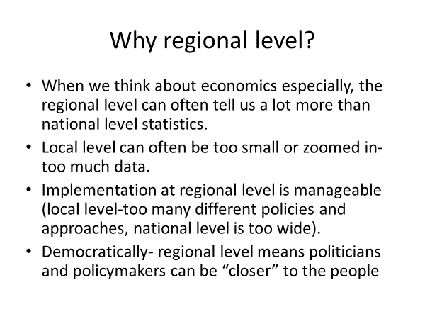

Slide 21
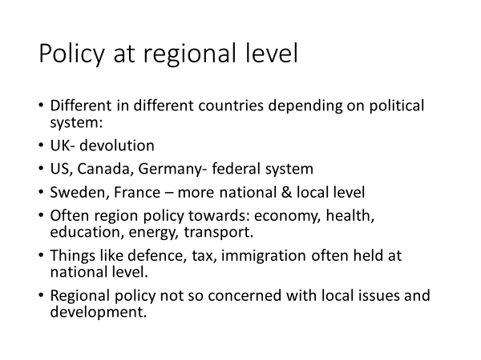

Slide 22
Regional Politics….

Slide 23
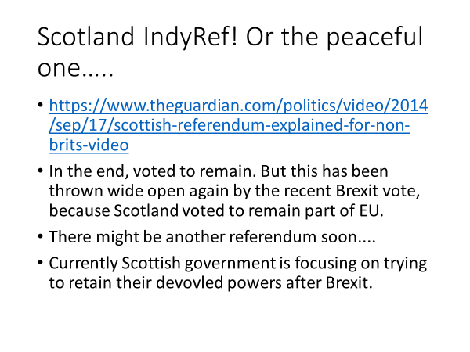

Slide 24
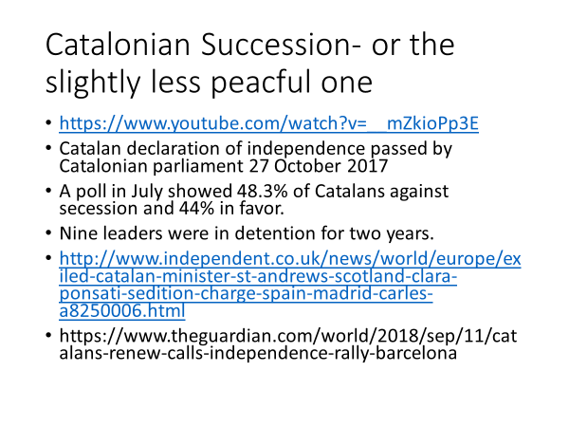

Slide 25
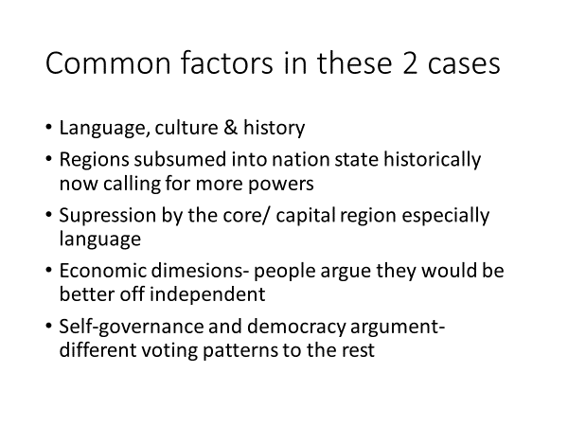

Slide 26
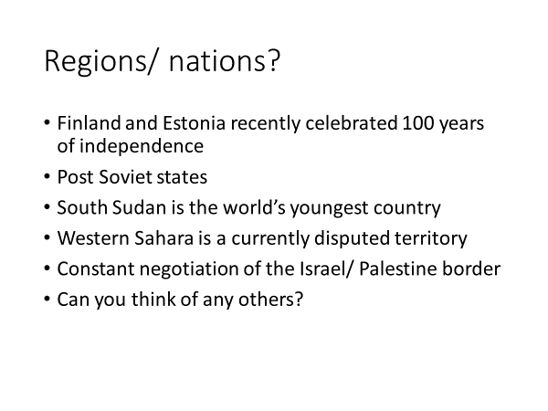

Slide 27
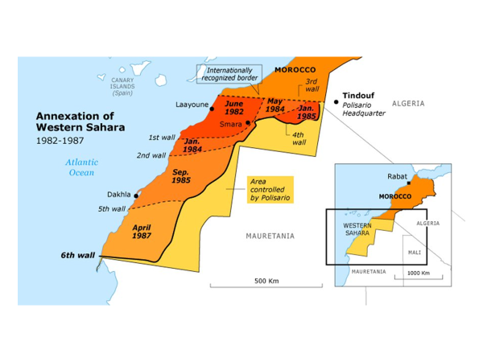

Slide 28
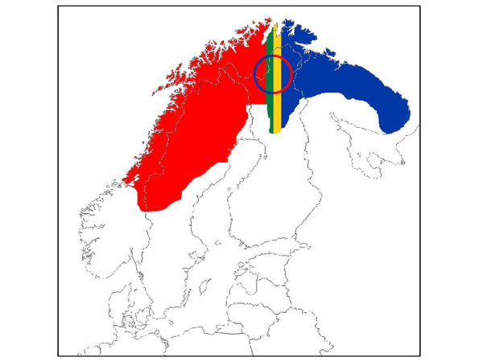

Slide 29
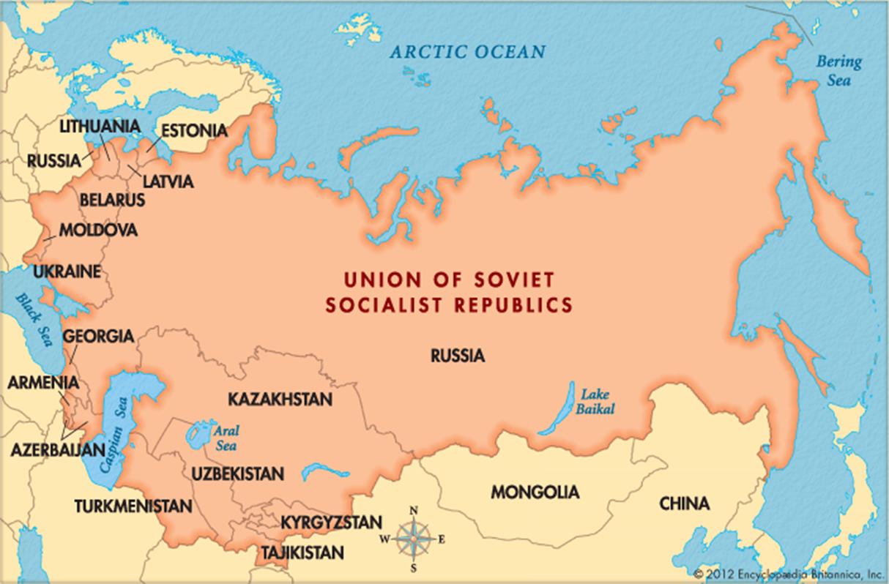

Slide 30


