Slide 1
Nurturing Resilient Leadership: Self-Care for Leaders in Challenging Times
Roundtable at the Melposium 2022
Tom Penny MEL19
Assistant Principal at the International School of Stuttgart, Germany
https://www.issev.de/campus-degerloch/
https://www.linkedin.com/in/tom-penny-a6839130/

Slide 2

What do we mean by this resilient leadership?
Cultivating and maintaning an ability to sustain our energy levels under pressure from disruptive changes and pressure.
Being able to effectively lead teams of professionals to inspire, challenge and support them to achieve ambitous goals over the long term.
Kohlrieser, G., Lavoie Orlick, A., & Perrinjaquet, M. (2018, August 6). Resilient leadership is best to navigate the pressures of working life. IMD business school. Retrieved August 18, 2022, from https://www.imd.org/research-knowledge/articles/resilient-leadership-navigating-the-pressures-of-modern-working-life/#:~:text=Resilient%20leaders%20have%20the%20ability,dysfunctional%20behavior%20or%20harming%20others.

Slide 3
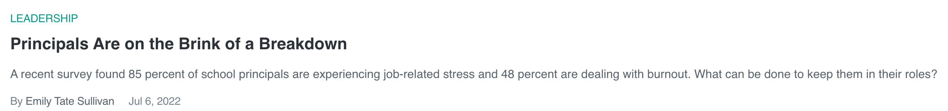
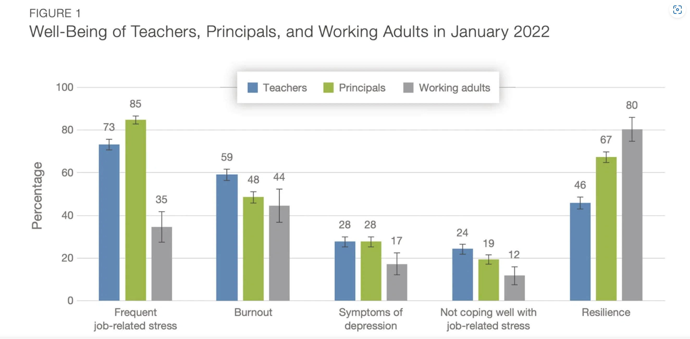
The context
Www-edsurge-com.cdn.ampproject.org. 2022. Principals Are on the Brink of a Breakdown | EdSurge News. [online] Available at: <https://www-edsurge-com.cdn.ampproject.org/c/s/www.edsurge.com/amp/news/2022-07-06-principals-are-on-the-brink-of-a-breakdown> [Accessed 18 August 2022].

Slide 4
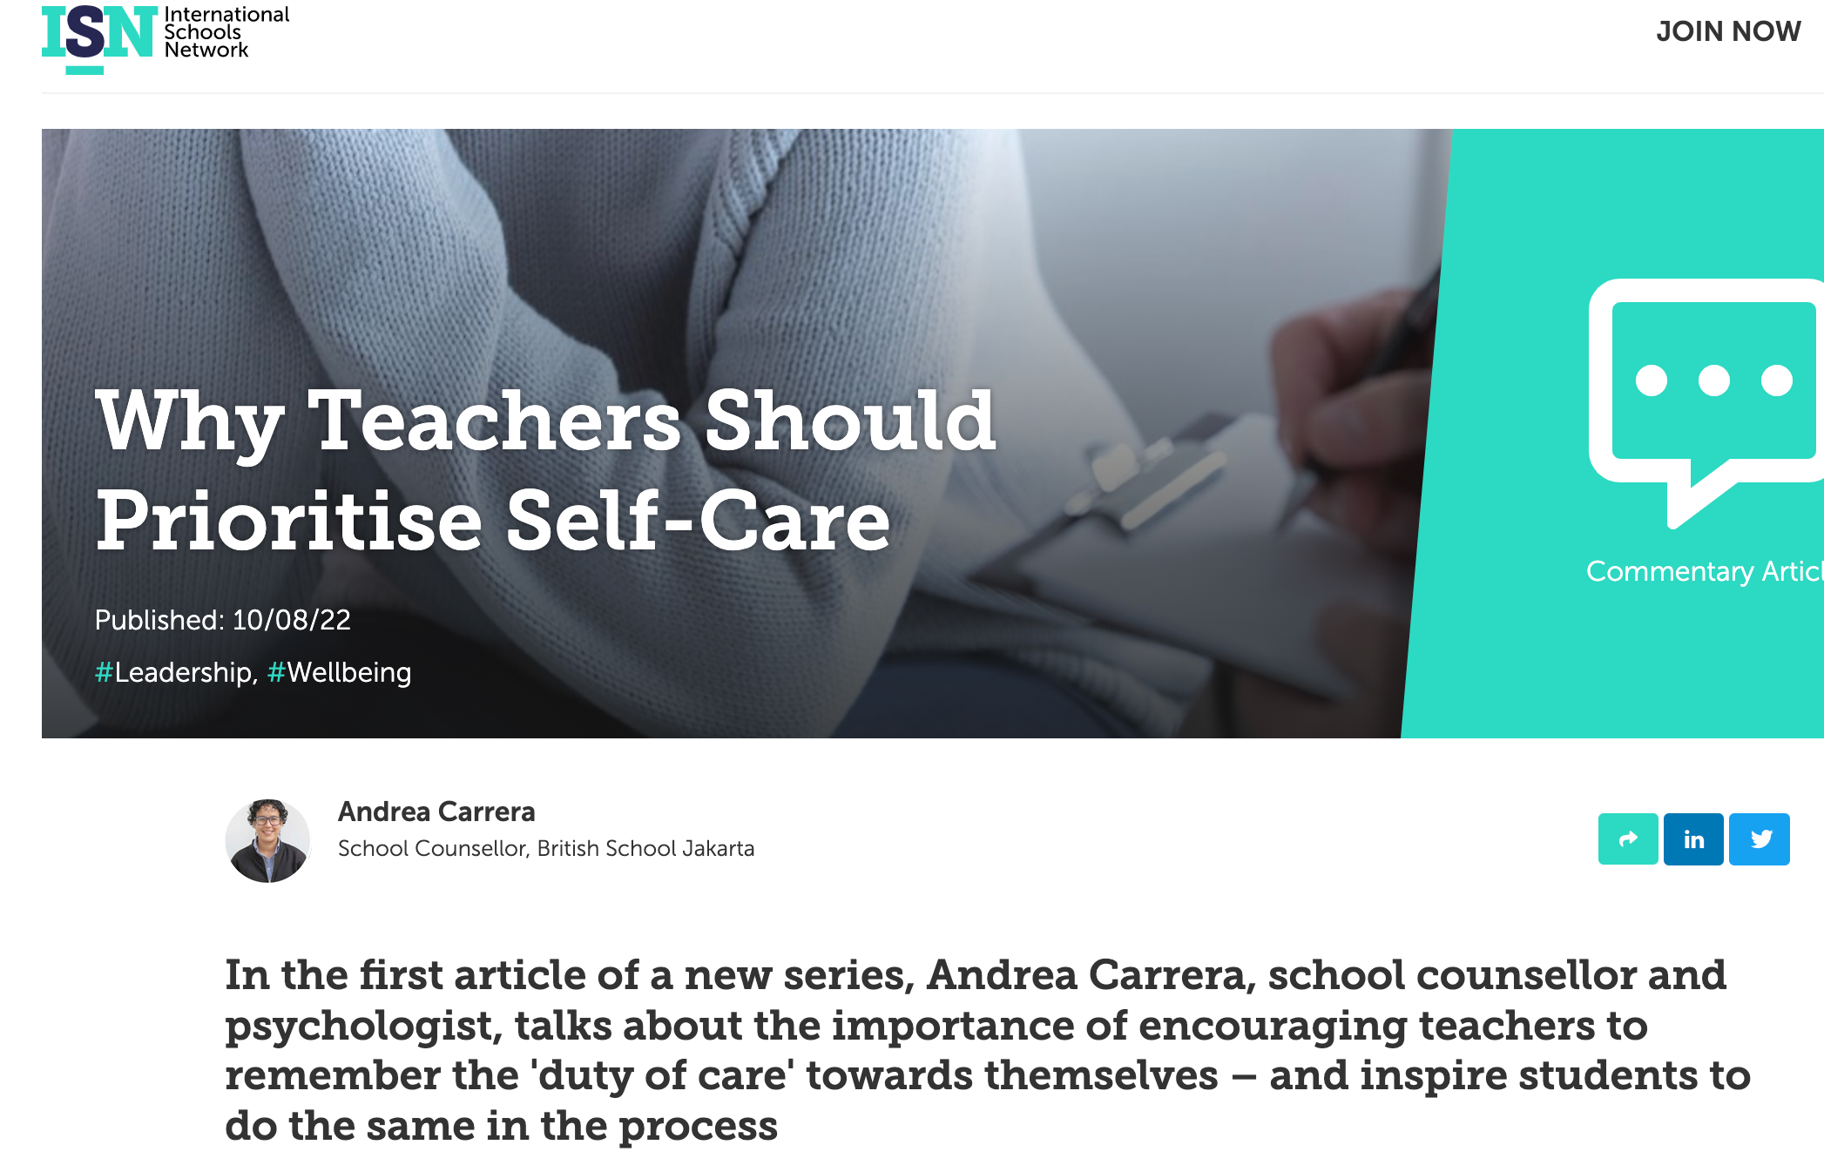
The context
Isn.education. 2022. Why Teachers Should Prioritise Self-Care - ISN. [online] Available at: <https://isn.education/articles/open/why-teachers-should-prioritise-self-care/> [Accessed 18 August 2022].

Slide 5
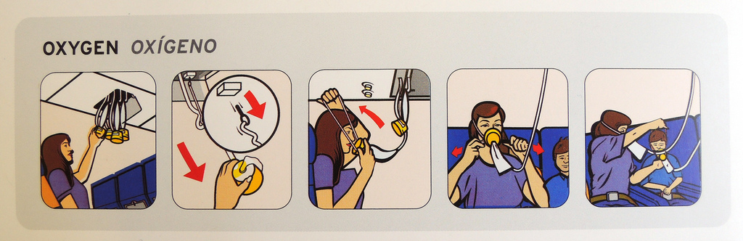
The context
Teacher of Grades 6-12 of over 130 students
Assistant Principal in a school of 440 students
Needs of staff and faculty at school
Parents and children at school who wanted support
Father of two children under 4 years old
Relationship to maintain with also tired partner at home with two children
Friends to see
Wider family to support
Covid demands
All the other things that life challenges us with
How could I develop and maintain my energy for myself, my family, my colleagues and the students in my care? How can I practice self-care to be able to care for others?

Slide 6
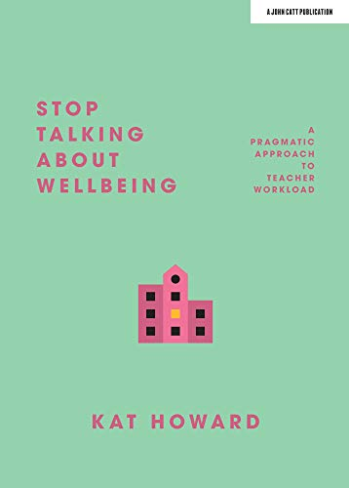
The context
Stop Talking About Wellbeing: A Pragmatic Approach to Teacher Workload: Amazon.co.uk: Kat Howard: 9781912906482: Books

Slide 7
How to move forward to build my own resilience?
I used a MICK framework to guide my reflections and plan for the months ahead.
The MICK framework allows us to discuss, reflect and plan for individual and group ideas and action.
More=what is working well that I should do more of?
Include= what should help me achieve our goals that I don’t currently do?
Change= what do I do that is important but not quite working at the moment?
Kick out=what do I do now that I could probably manage without?

Slide 8
8 Steps for resilient leadership according to Center for Creative Leadership
8 steps for more resilient leadership: Center for creative leadership. CCL. (2022, June 21). Retrieved August 18, 2022, from https://www.ccl.org/articles/leading-effectively-articles/8-steps-help-become-resilient/
Increase physical activity
Get enough sleep
Boost mindfulness
Challenge your assumptions
Savour the sweet things
Practice gratitude
Build social connections
Engage your senses, including touch

Slide 9
Thanks for sharing and developing our ideas
Please stay in touch and share more links, ideas, projects to support our educational leaders.
https://www.linkedin.com/in/tom-penny-a6839130/

