Slide 1
Can ‘agency’ be a useful concept to analyse the ‘experience’ of the Patarine movement?
Milan, Italy, 1057-1075
Piroska NAGY
(GRHS, UQAM – UMR Télemme, AMU)

Slide 2
The historical moment of the Pataria in Milan
« Pataria » is the (pejorative) indigenous name given to a radical religious reform movement in Milan, Italy, in the 11th c.,
which was born at the very beginning (1057) of the pontifical phase of the great reformation-transformation of western Church and society,
challenging, namely, the validity of sacraments of simoniac (corrupt) and married (‘impure’) clerics → ie, questioning in fact both the way of life and the social power of the Church, strongly linked to aristocracy.
Led by two minor clerics – Arialdo and Landulfo, and later a knight, Erlembaldo, the movement targeted the ecclesial hierarchy and firstly, the archbishop, Guido da Velate, main lord of the city.
The movement was followed by many citizens and the debates and fights divided the town for almost 20 years.
Arialdo dies martyrised in 1066; Landulfo, probably from the consequences of an attack, c. 1061-62 ; Erlembaldo, in a street fight in 1075.

Slide 3
The particularities of the movement
An exceptional documentary situation : while in the Middle Ages, in general only the winners’ narrations and documents were conserved, for the Pataria, we have abundant documentation from both sides : narrative texts, documents, letters…
→ the reasons for this :
2) As it occurs in an early stage of the pontifical reform, the position of the Church – and, first of all, of popes – is not well defined, and not traditional: during an important part of the movement, the reformer pontifical court supports the patarines.
3) Success or failure ? political failure in local terms; success on the long term = the Church reform won → in 1099, translation of the rests of Arialdo and Erlembaldo.
These reasons explain why we have such an exceptional case when investigating 11th century collective experience and agency is not condemned in advance.
Trying to compose a microhistory of the Pataria, I meditate about the framework, terms and their use → interested in the patarine experience.

Slide 4
Experience
Experience has become a key concept in this project: how the different actors, individual and collective, lived, practiced and worked out what happened during these movemented years ? What were the motivations, their experiences ?
→ The Pataria was a religious, social and political experience – experimentation in the town of Milan:
In this radical reform, religious experience and its efficacy is at stake ; it is omnipresent and instrumental in the success of Arialdo, more than his personal ‘charism’ → raising the issue, what religion meant for 11th century Italian people, clerics and lay fellows? => religion as a lived practice made of performances, processes, concepts as experienced – all this, shared AND individual.
Political experience and experimentation : this episode is considered by historiography as one of the first moments when the ‘city’ starts to act in an autonomous way, as the count has already disappeared, the emperor is far away, and the authority of archbishop, the main power of the city, is challenged => this leads to a shared political experience during which vow or pledge is frequently used to collectively decide.
Experimentation of a massive social engagement: solidarity, but also changing positions of the ‘people of Milan'
Individual experience is sometimes known : besides the authors of the three main narrative sources who all write sometimes in the 1st person, all of whom were eye-witnesses, the names of many figures are known: from Peter Damiani, a prolific papal legate; the archbishop, Guido da Velate; Anselmo da Baggio, the futur pope Alexander II… also a series of « minor » patarini, and some of their clerical and lay allies = many testimonies, experiences.
Narrative sources use sometimes a strong emotional discourse and rhetoric – both for individual and collective motivations, actions : reflecting the emotions of the authors – they echo the tension they describe → a figure of the topic « madding crowd » (C. McPhail)
Experience of space, its use and appropriation : sacred / profane space ; inside / outside the town ; links between city and contryside ; different districts, churches and saints involved, as well as the allegiance of the town-dwellers and of the inhabitants of the suburbs

Slide 5
Agency
At a period when we do not have any evidence of common people’s individual actions,
When history-writing is attached to describe lives and acts of the leaders, the elites,
➔ what use of AGENCY ?
First, I used it to name collective / popular mobilisation, action;
In the sources, people do not speak, they act – in very diverse ways.
« putting people back in the past » → has already been done (C. Violante, 1977; O. Zumhagen, 2001)
Designating by ‘agency’ the power of common people to act on the social / historical stage = OK, but what for ? And in what way ? What about agency and violence ?
→ Using the concept ‘agency’ made it necessary to appropriate the notion, elaborate it further :
Especially as at some moment, the people of Milan decides on its own : not as it would be expected to act (by the leaders, by the Church, etc) but as then, people decide. What, and why, and how do they decide ?
  Omnipresent use of oaths
How far agency can be collective ?
  YES for societies where community, tradition and culture have a great importance in the definition of beings, their potential actions, possibilities
  given repertories of action < Charles Tilly – which define the modalities of actual action, its space and possibilities
  In some contexts, who is acting is ambiguous !!!
Can agency be attributed to non-human actors, like God and saints ?
  Hagiographical texts, medieval chronicles… = the world of 11th c. Milan is a world where God is an active agent

Slide 6
A relational view of agency (< J. Robb)
John Robb (2010) ‘Beyond agency’, World Archaeology, 42:4, 493-520:
‘Social systems form specific kinds of persons, arrange them in social relations and provide them with resources and options for action. ’
‘Moreover, power is not possessed […]; it creates people; our desires, responses and strategies derive from a particular cultural historical order which as natives we never see in its totality.’
=> ’agency is not characteristic of individuals but of relationships’;
= it has to be defined within particular historical settings. → for me, various repertories of action
=>> this helps to « appropriate » the notion of agency in whatever context.
Especially as actions do always involve other people ; they depend on social contexts and on institutions:
‘A key parameter of how people construct their agency in a given situation is their understanding of the relations with others »
In this sense, both God and his saints and collective entitites can be attributed agency.
In which case, the individual intentionality, volition may be put aside – which helps a lot sometimes with medieval sources and collective agents : the question is rather meaning.

Slide 7
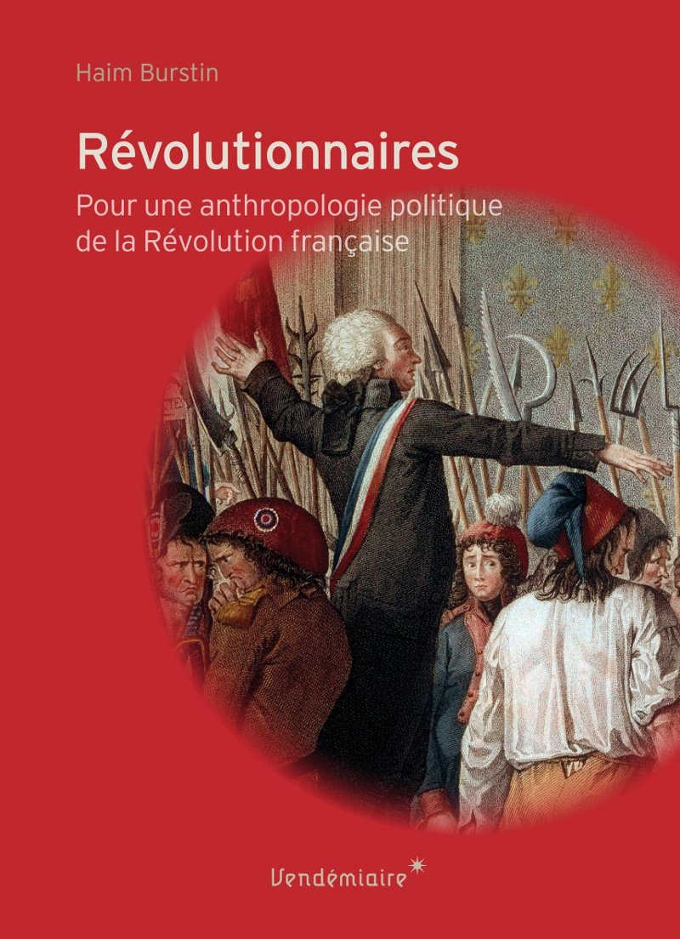
From agency to protagonism
Another useful notion, in my context, to go beyond the lack of definition of ‘agency’:
Protagonism < Haïm Burstin, a specialist of French Revolution
  ‘La biographie en mode mineur : les acteurs de Varennes, ou le « protagonisme » révolutionnaire’, Revue d’Histoire moderne et contemporaine, 2010;
  Idem, Révolutionnaires. Pour une anthropologie politique de la Révolution française, Paris, Vendémiaire, 2013.
+/- defined as « an intense form of political participation, or a potential or embryonic act of heroism » (Révolutionnaires, p. 183)
Revolutionary (or: critical) moments create occasions when a series of attitudes and behaviours witness of the adhesion to the Revolution: by them, the lives of ordinary people are turned upside down, so that they do unexpected things that link them to the Revolution => they become protagonists «in the minor mode » (‘La biographie)
Protagonism means participating in some way History with a great H – even if the actor(s) is/are ‘minor’.
The anonymous Patarini of Milan were protagonists of the history of Gregorian reform on the scale of the whole Christendom, and they took part to the history of the town of Milan, on the long term.

