Slide 1

Louise Nyholm Kallestrup, Director of Centre for Medieval and Renaissance Studies, University of Southern Denmark
Short presentation:
In some of my earlier work, I have studied the meaning of witchcraft. What were people talking about, when using the term witchcraft, and other concepts within this semantic sphere? What was the meaning – or meanings - to the ones in power, as well as the ones on trial? This was the theme of my comparison of Danish and Italian witch trials.
My sources are a broad selection of written documents. I have worked a lot on trial records, legislation, manuals, theological treatises, correspondence and devotional literature. In my current project I have added visual sources.
Current project (monograph):
The Construction of Witchcraft in Early Modern Denmark. Experience, Emotions and Gender (Routledge 2022)

Slide 2
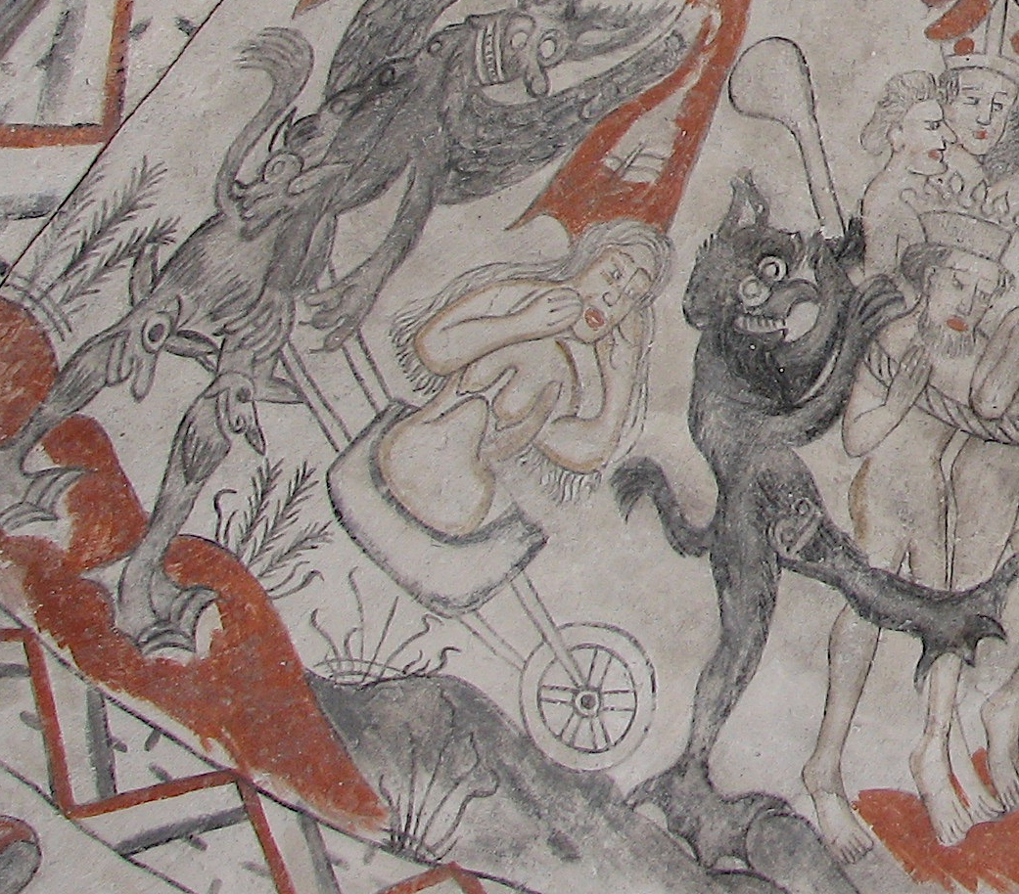
The Construction of Witchcraft in Early Modern Denmark. Experience, Emotions and Gender
How witchcraft went from being prohibited by the law (and Bible) to a top priority to Danish powerholders to legislate against (1617)?
Argument: Construction through a fusion of
1. Evangelical reformers’ Apocalyptic worldview
2. Changes in what make a good Christian woman and the clash with traditions in folklore of (strong) evil women.
3. The agency of certain crucial powerholders. Especially the king and his inner circle.
Beliefs in witchcraft as epitome of lived religion
Religious and secular worlds knit together

Slide 3
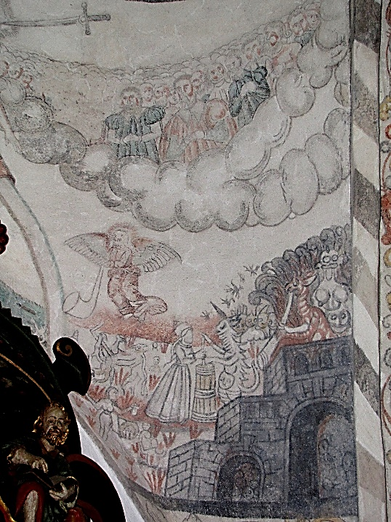
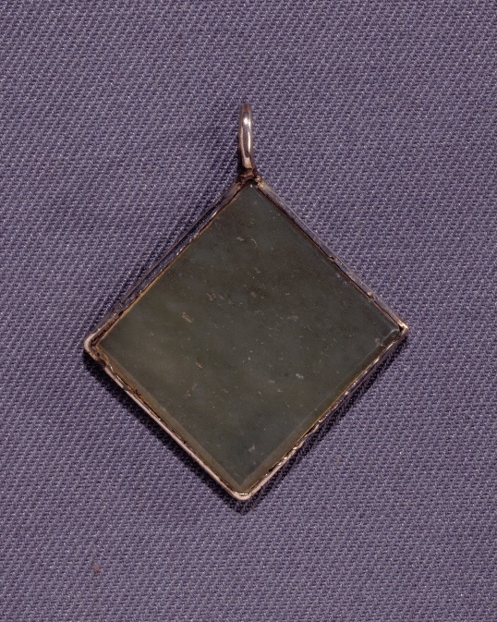
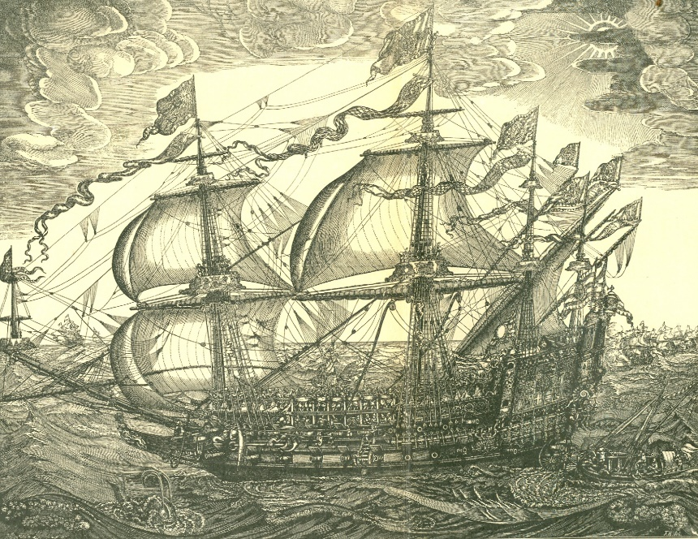
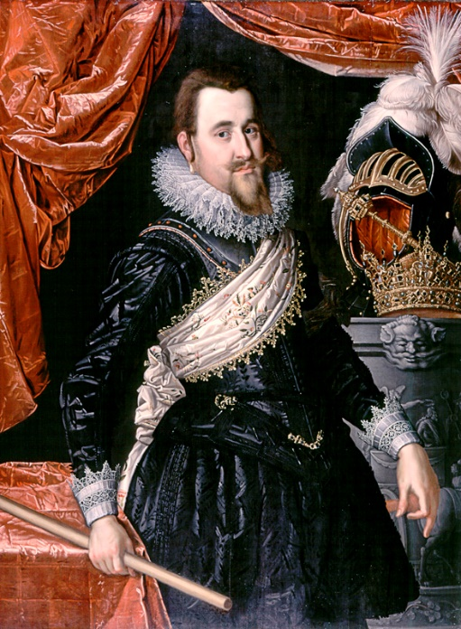
Starting point: A bewitched bridal journey. Princess Anna travelling towards Scotland. 13 people executed in Cph in 1590
The trials took place in age, where the Lutheran-Evangelical messages of the imminent Second coming and the need for penitence became still more frequent. The young king came to the throne in this religious climate and interpreting experiences accordingly. Several of the men travelling along with the bridal company would join the King in his future expedition to the far North of the kingdom, where he encountered the vicious and dangerous Sami witchcraft, and on his first travel to England. In the 1610s, when the issuing of disciplinary laws became still more frequent, it was their sons and sons in law whom had become the prominent figures in the King’s council and in other powerful offices. It was their ideas and their experiences of witchcraft which contributed to construct witchcraft as a high priority offence to eradicate.
The king’s amulet for protection against misfortunes and witchcraft
One of Christian IV’s ships
Hell. Scenery from church mural
depicting the Second Coming.
Parish church of Holbøl
Christian IV, c. 1611-16

Slide 4
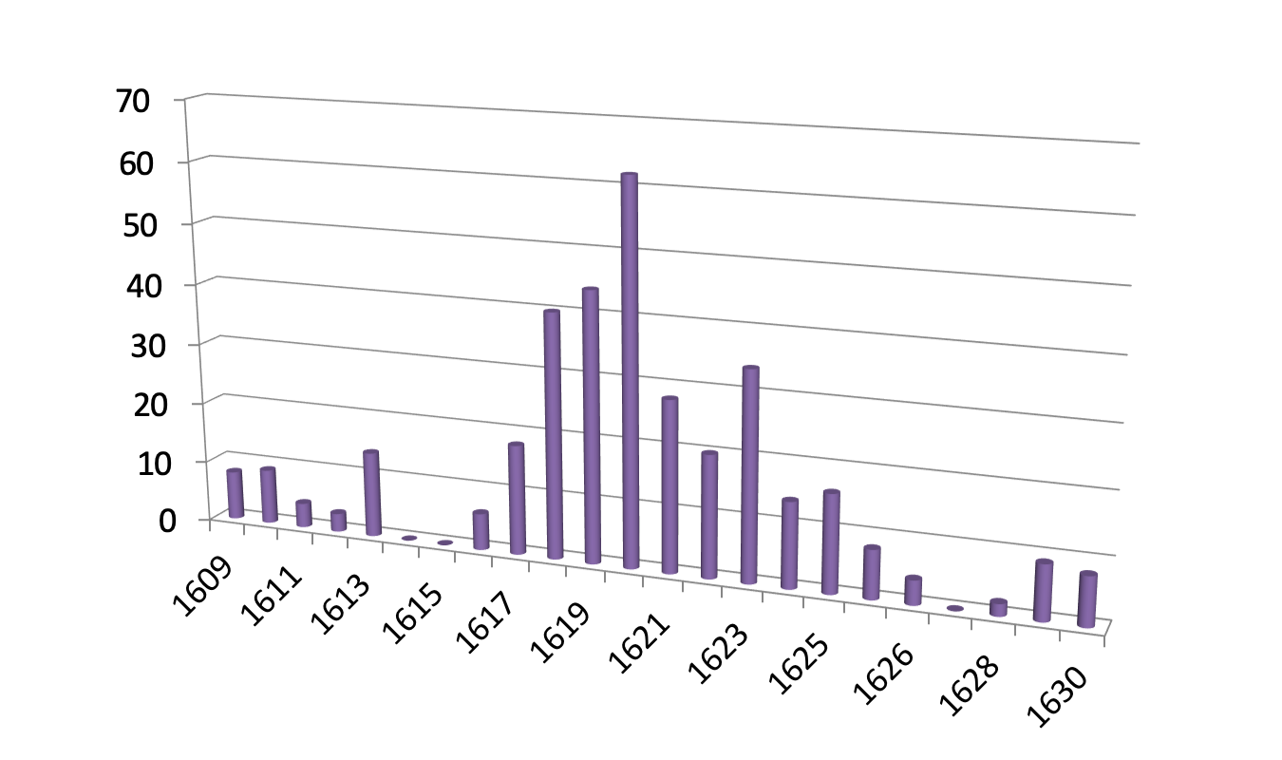
Witch trials in Denmark (Jutland), Witchcraft Act issued 1617
Source: Jens Christian Johansen, 1991

